Slide 1
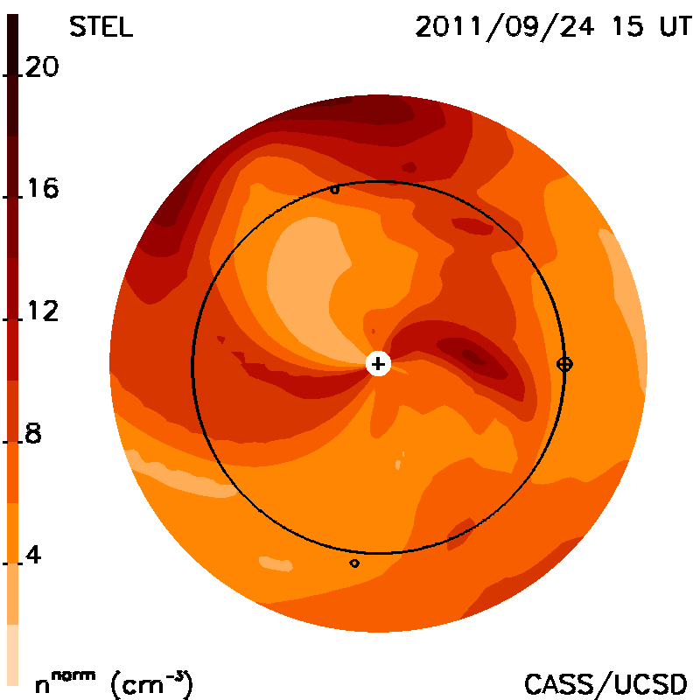
0.145”=0.0725AU
1AU=2.0”
0.335”=0.1675AU
0.495”=0.2475AU
0.66”=0.33AU
0.825”=0.4125AU

Slide 2
CME 1 – 12:48UT
AU | Leading Edge time | Black Edge time
0.0725 | 14:29 | 15:09
0.1675 | 17:29 | 20:09
0.2475 | 21:29 | 02:09
0.33 | 02:49 | 08:49
0.4125 | 08:49

Slide 3
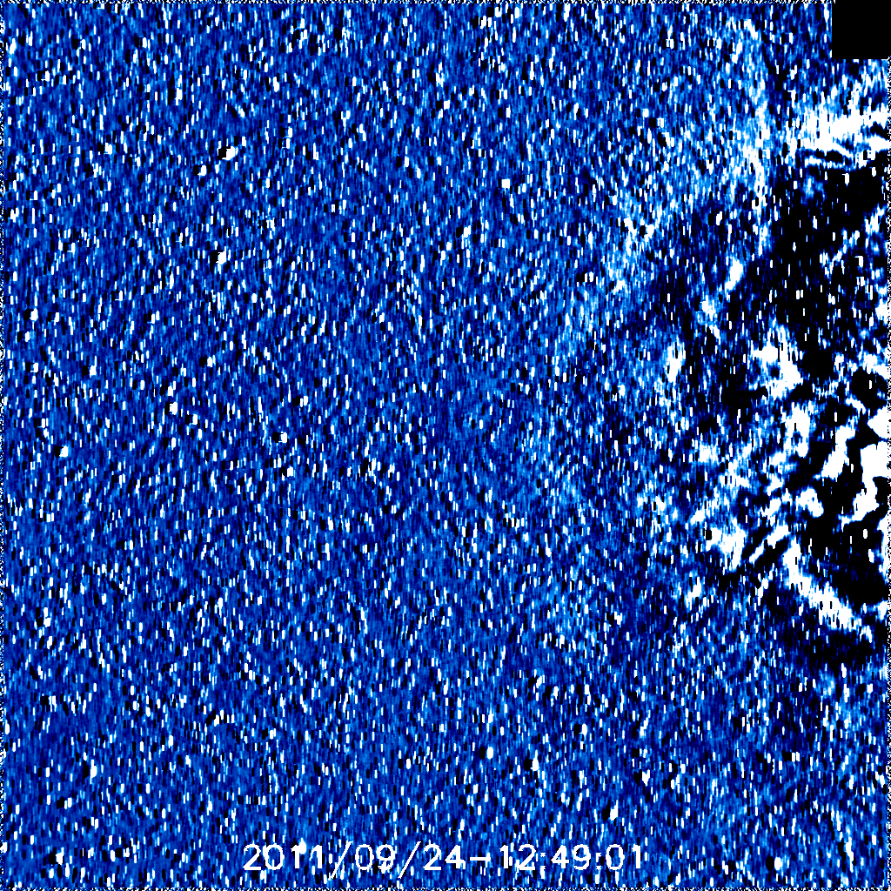

Slide 4
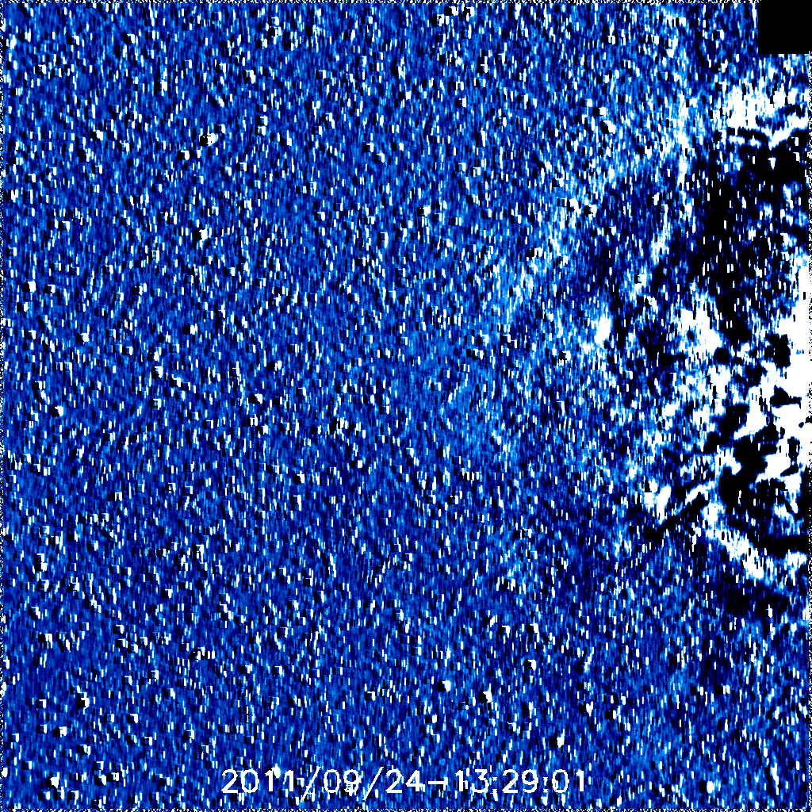

Slide 5
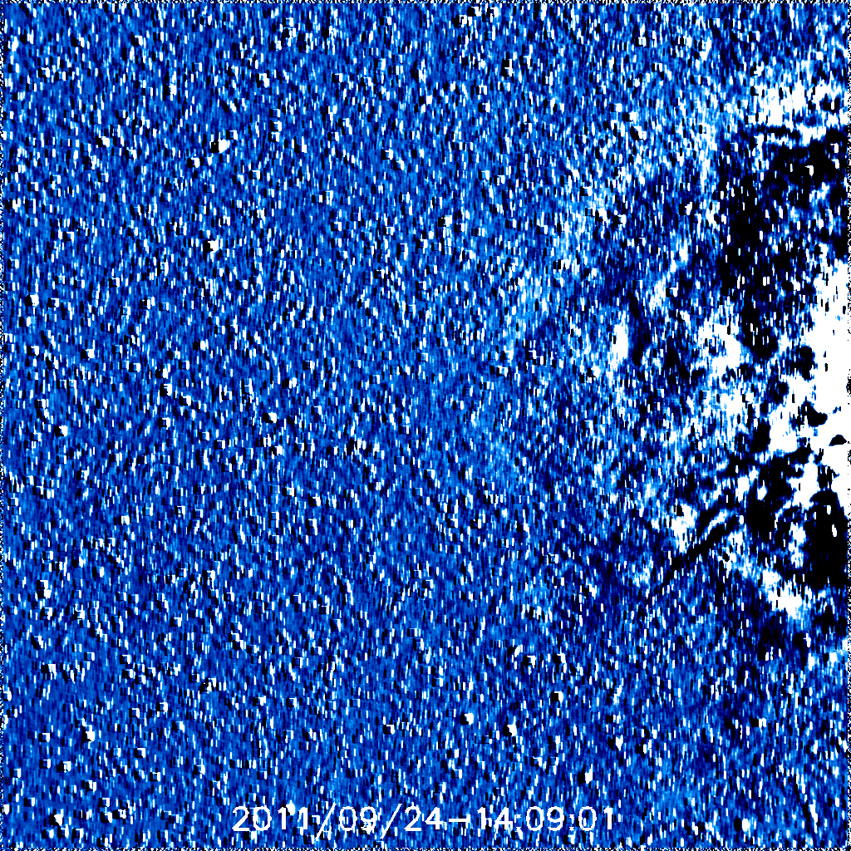

Slide 6
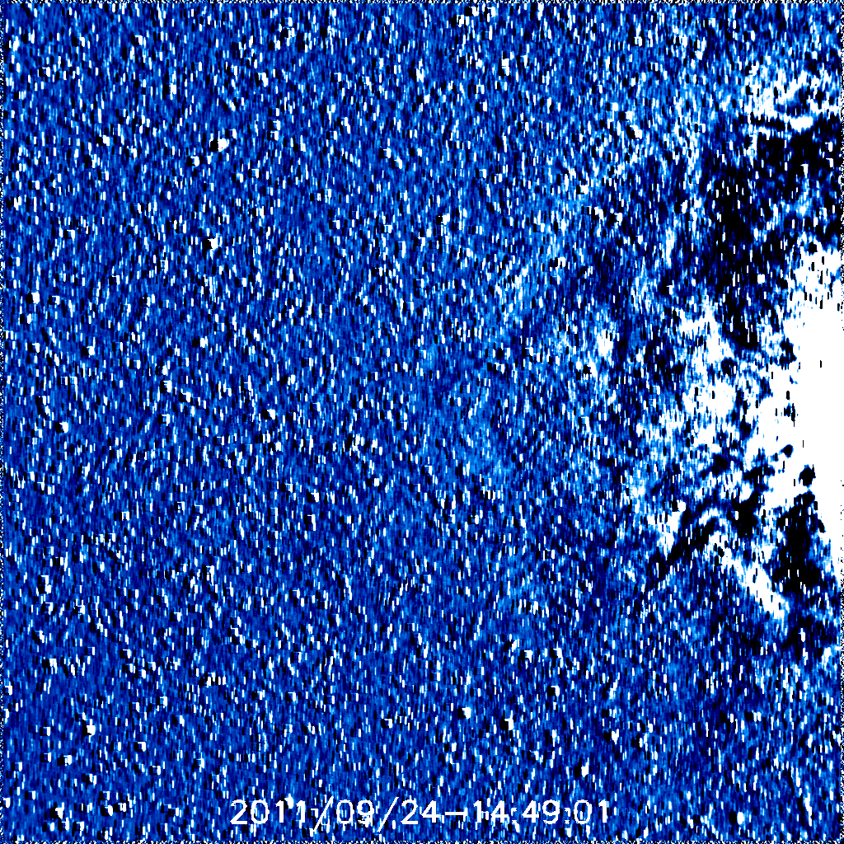
14:29

Slide 7
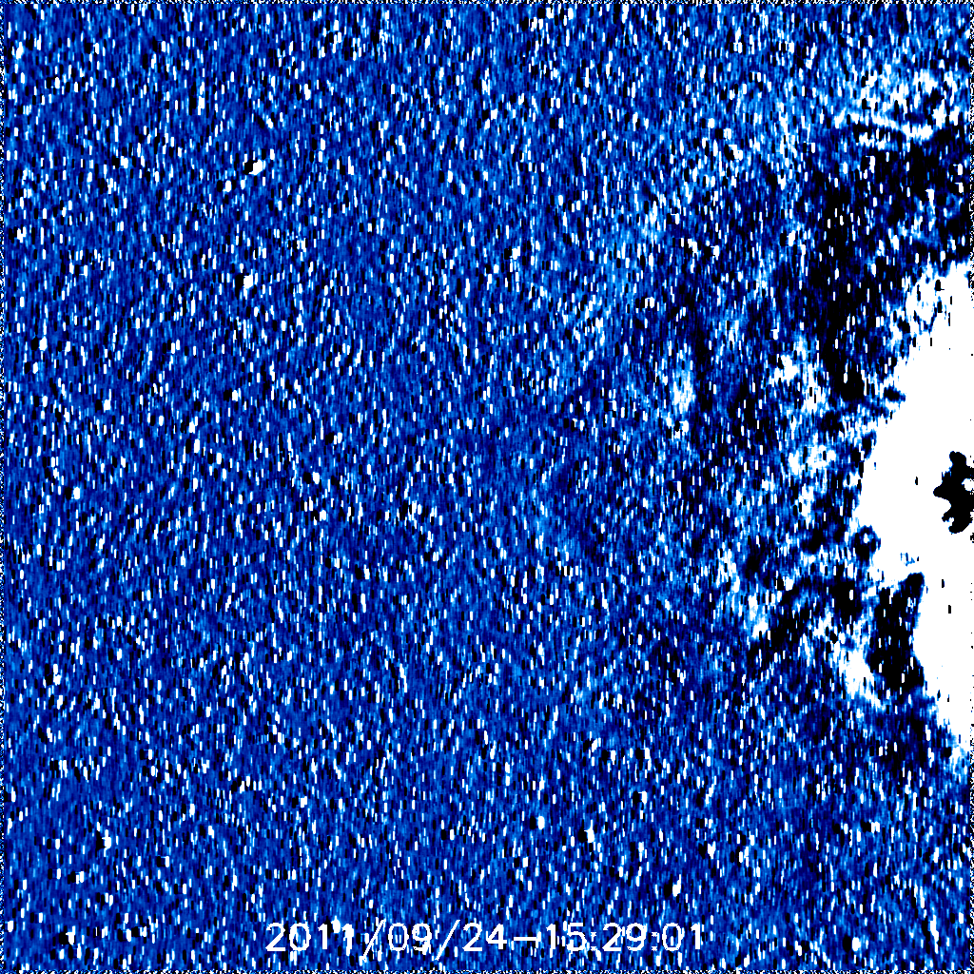
15:09

Slide 8
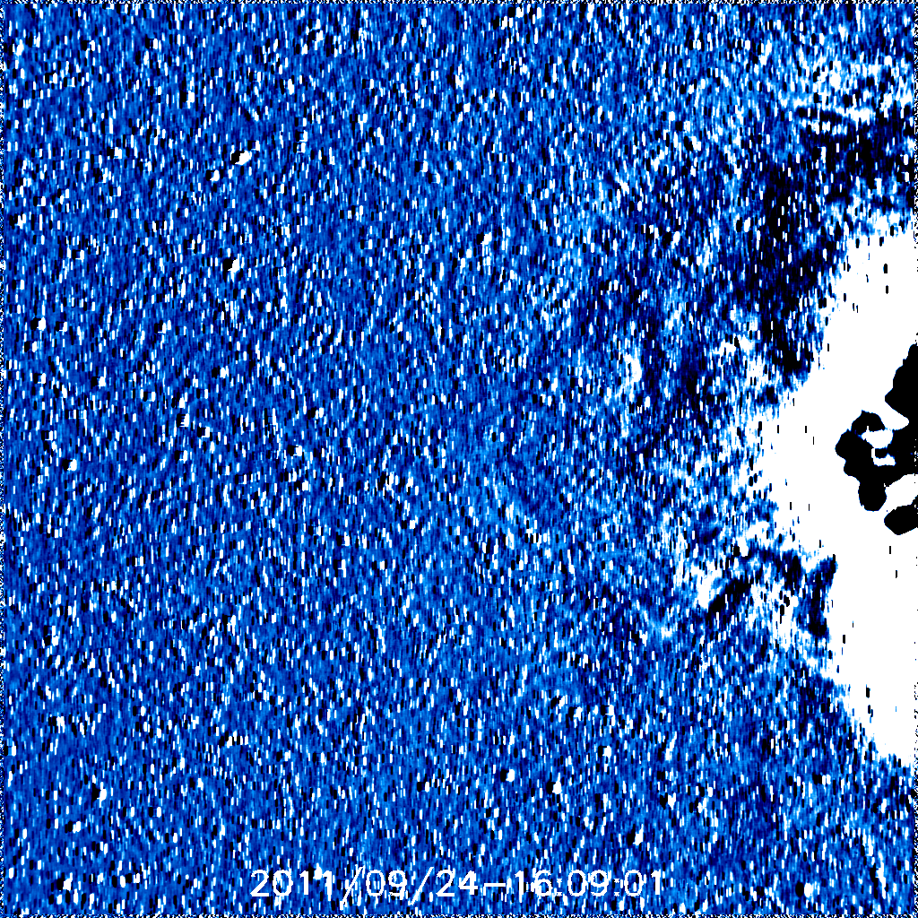

Slide 9
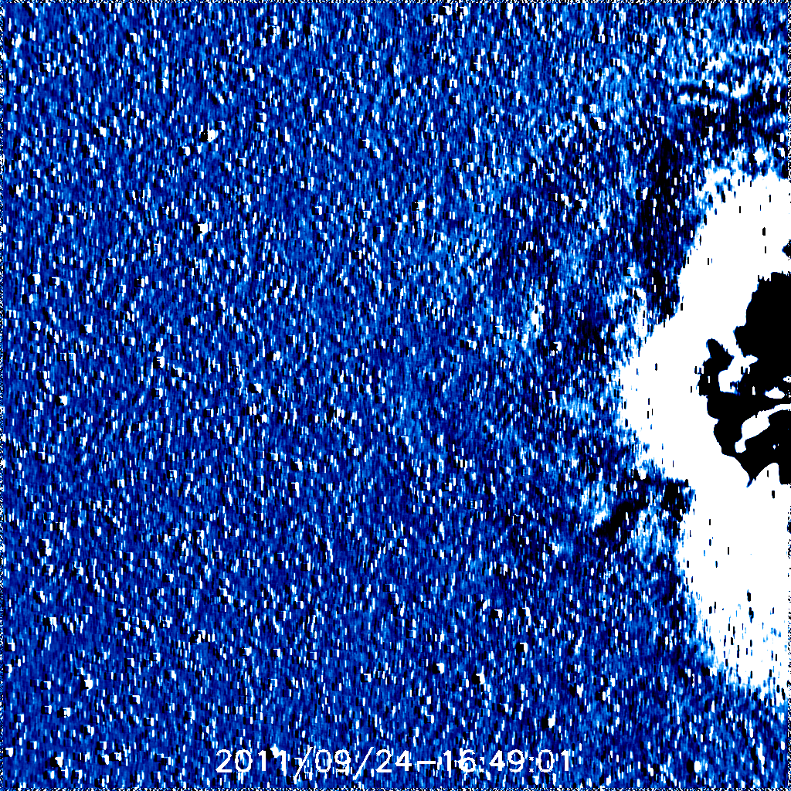

Slide 10
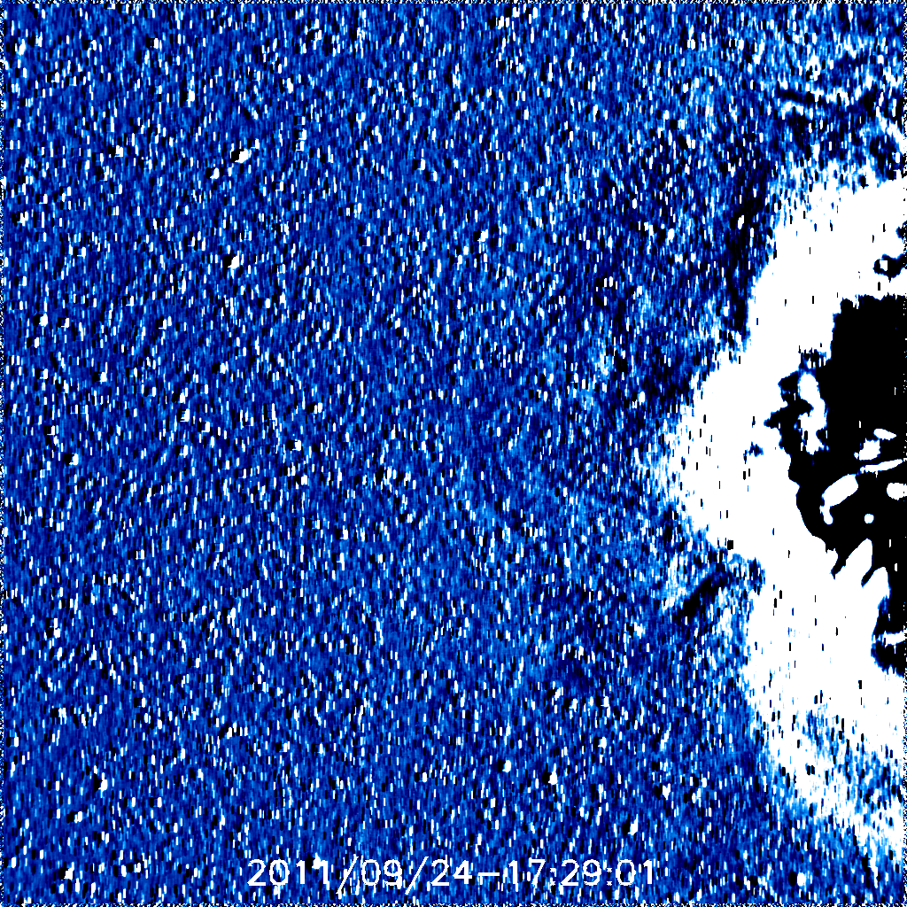
17:29

Slide 11
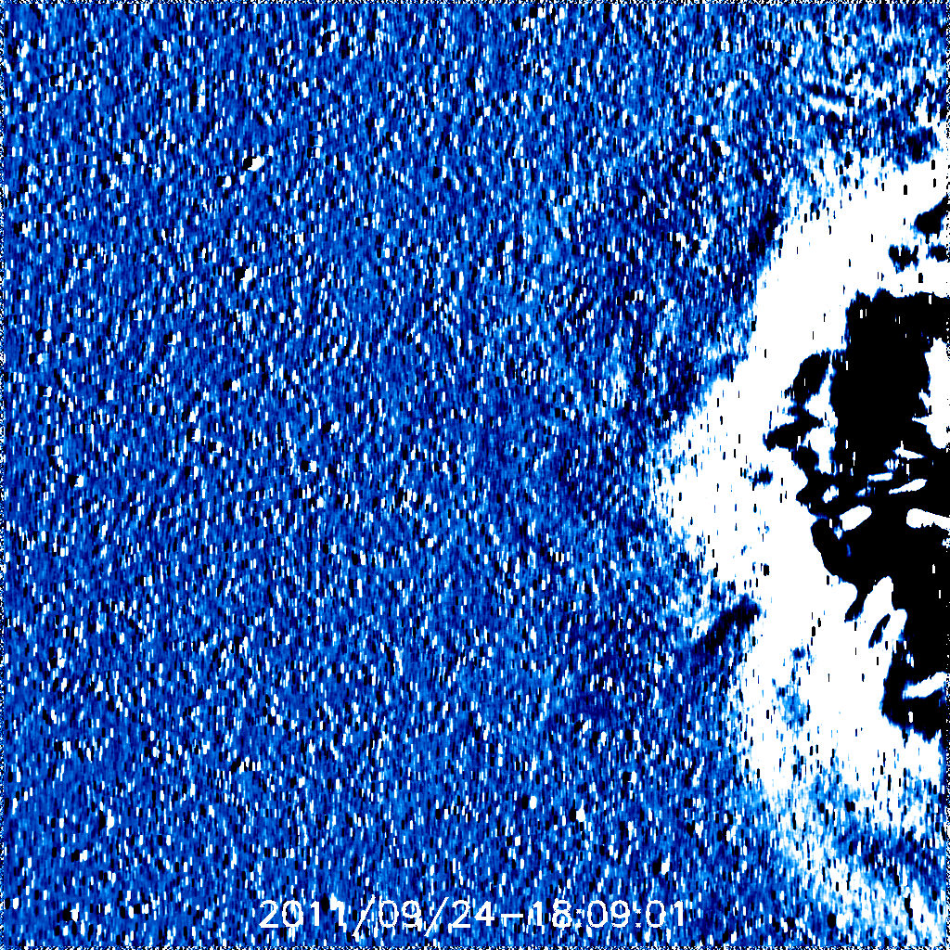

Slide 12
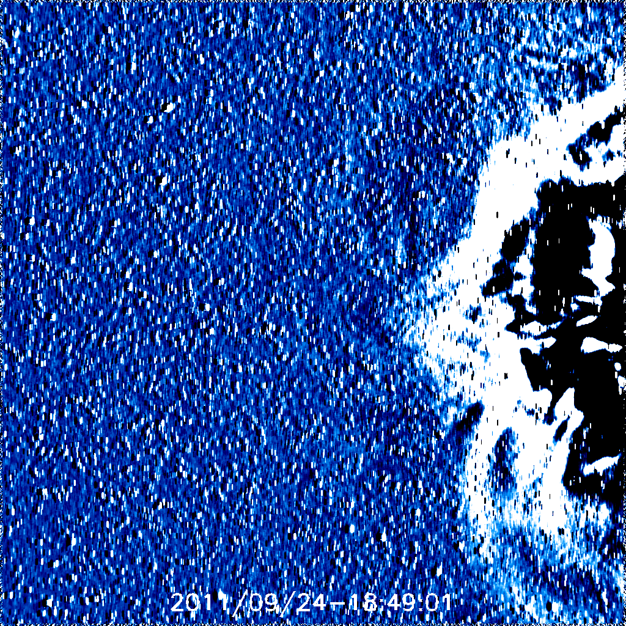

Slide 13
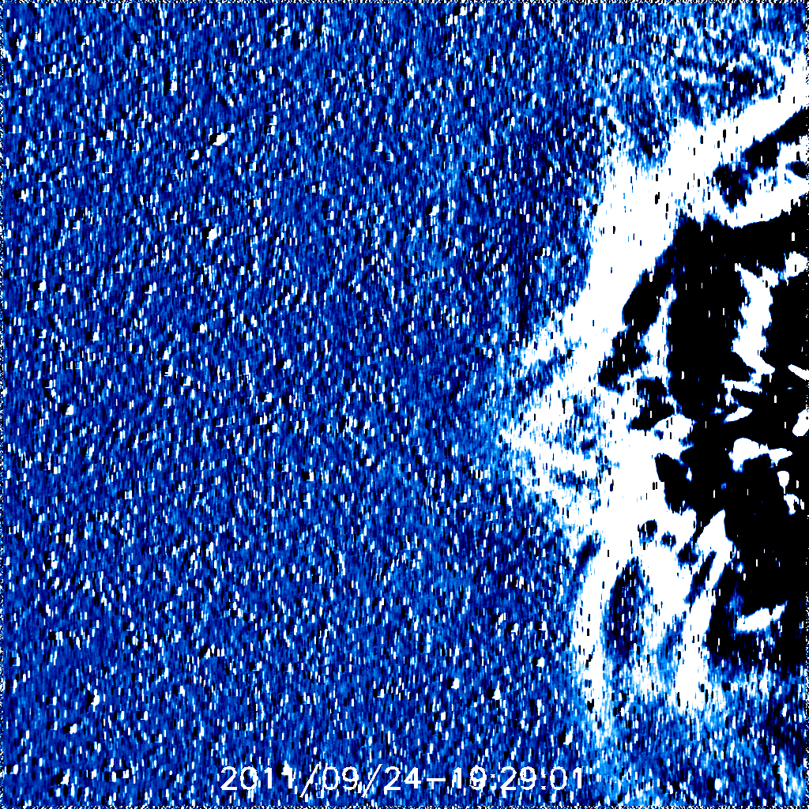

Slide 14
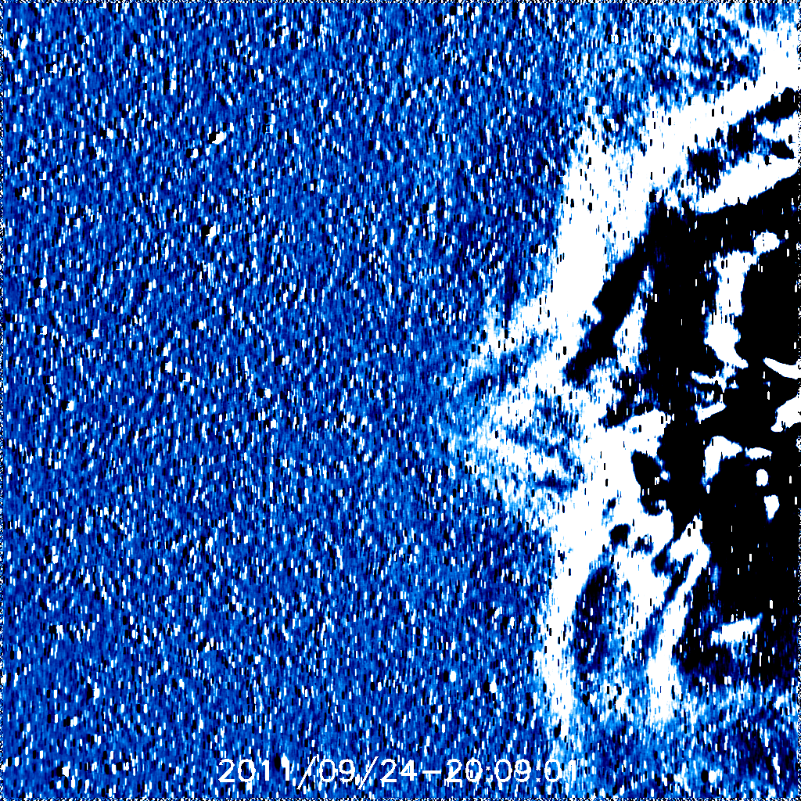
20:09

Slide 15
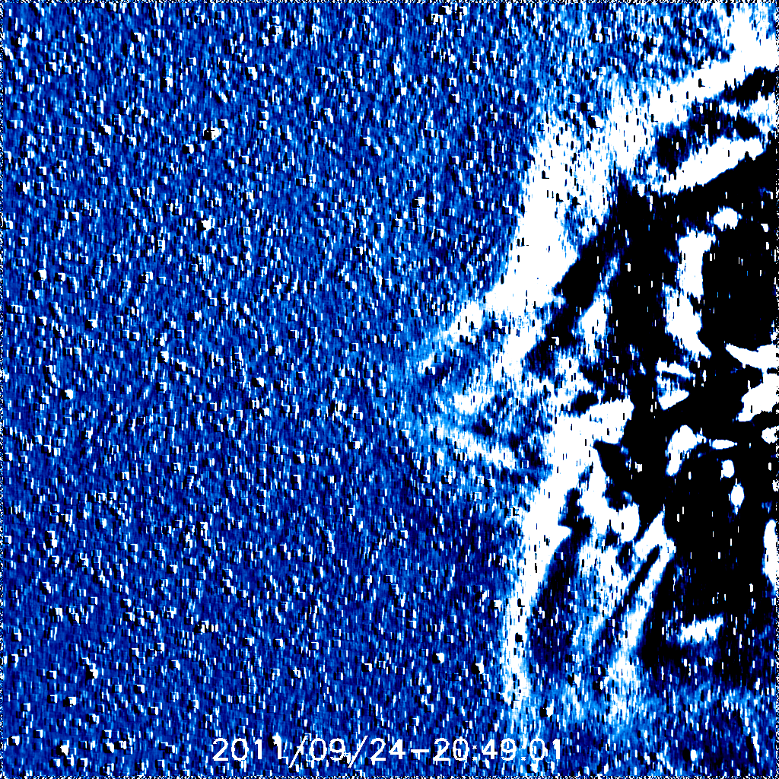

Slide 16
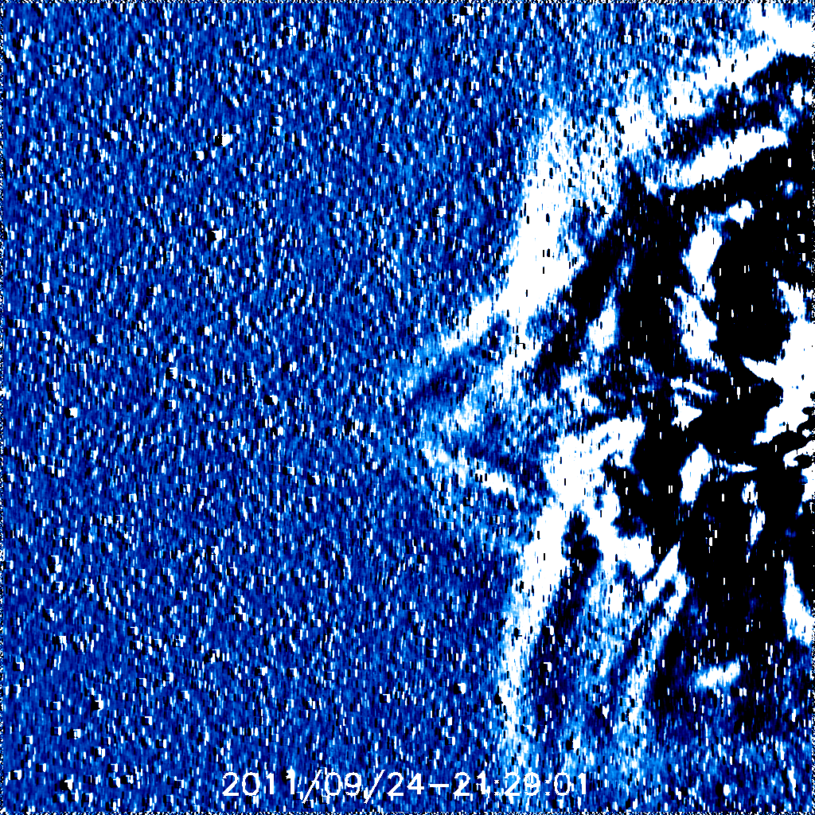
21:29

Slide 17
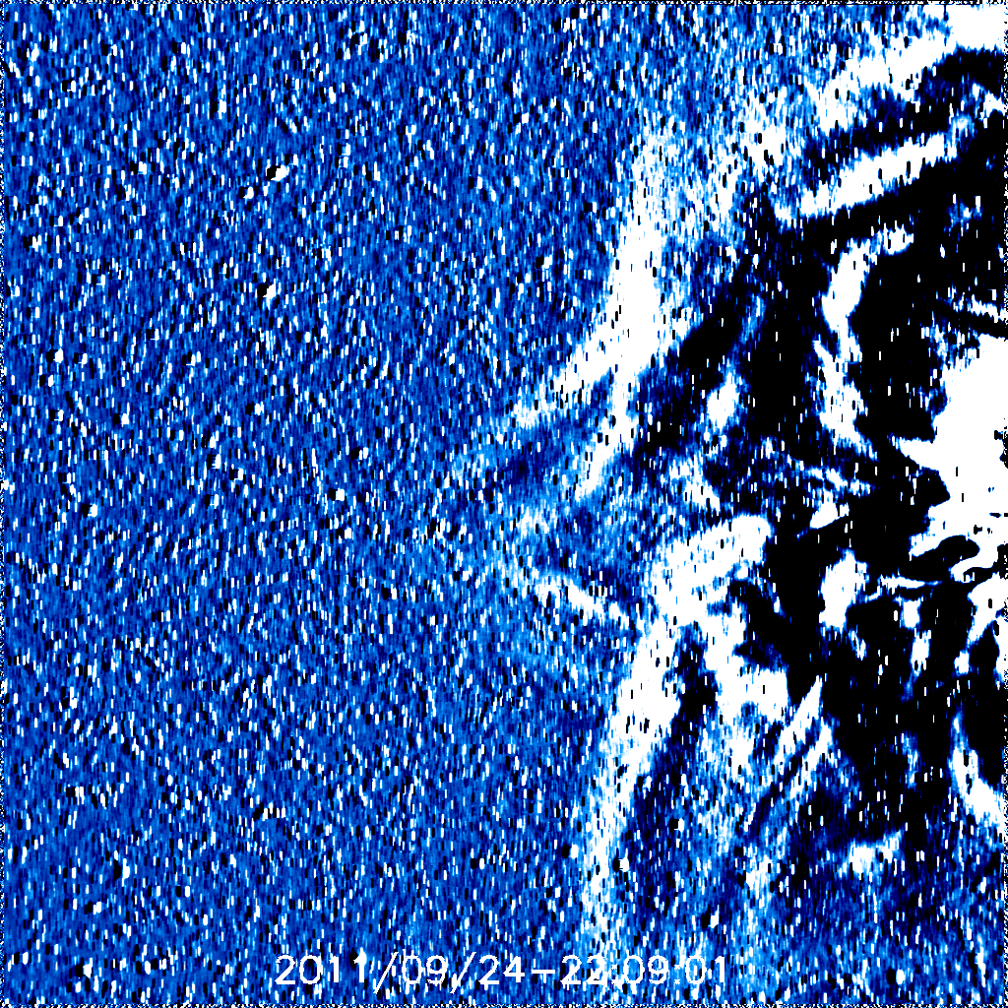

Slide 18
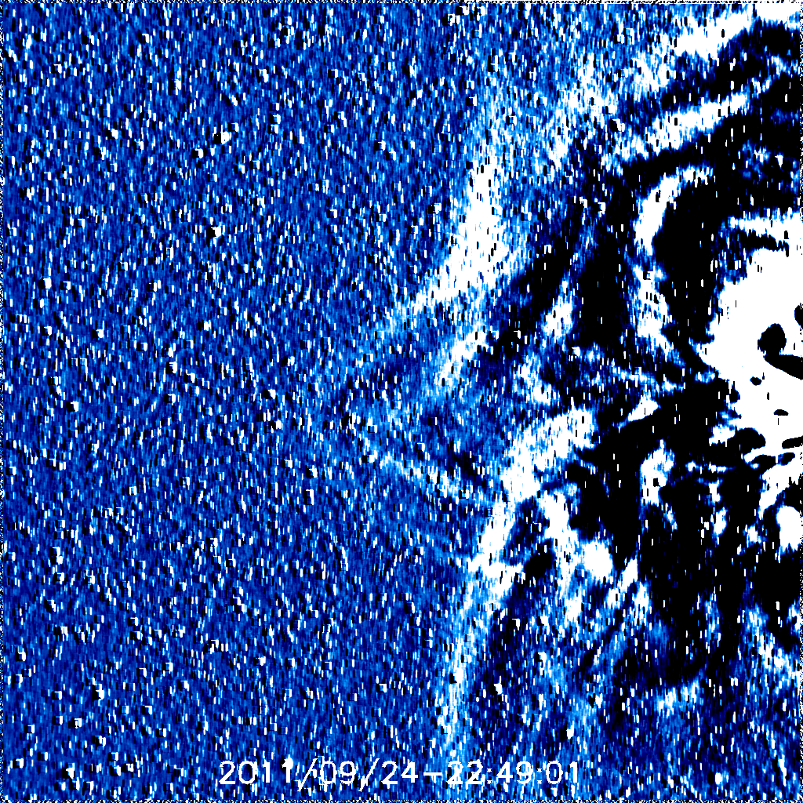

Slide 19
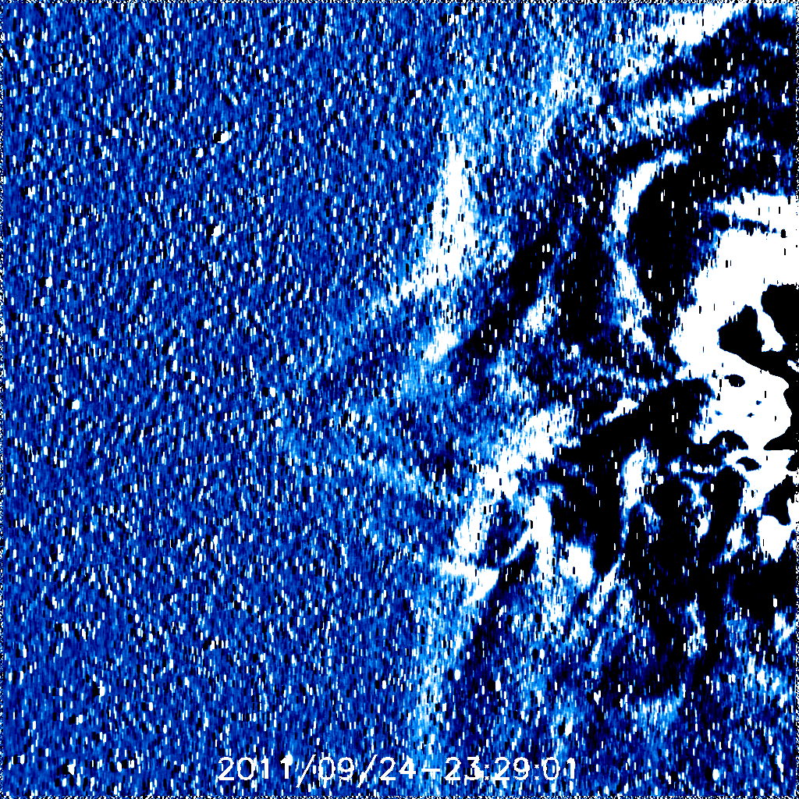

Slide 20
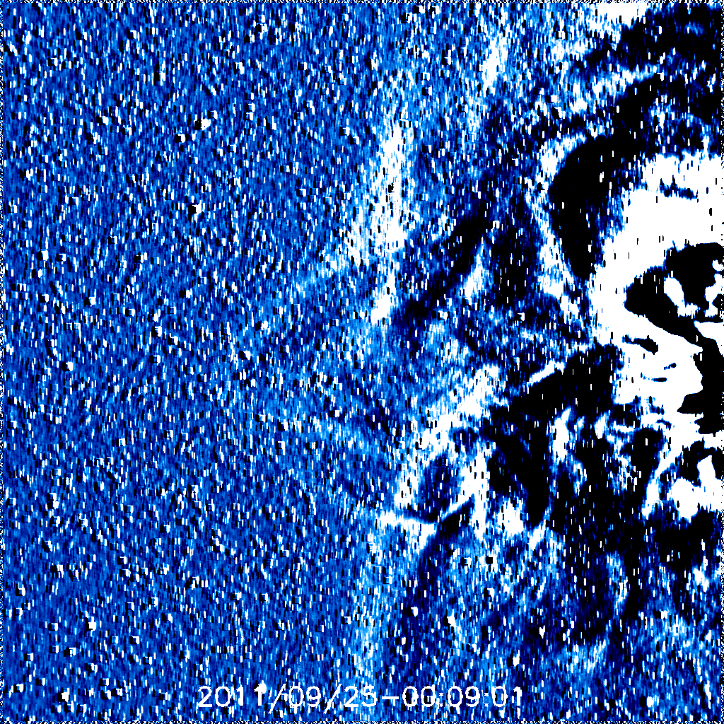

Slide 21
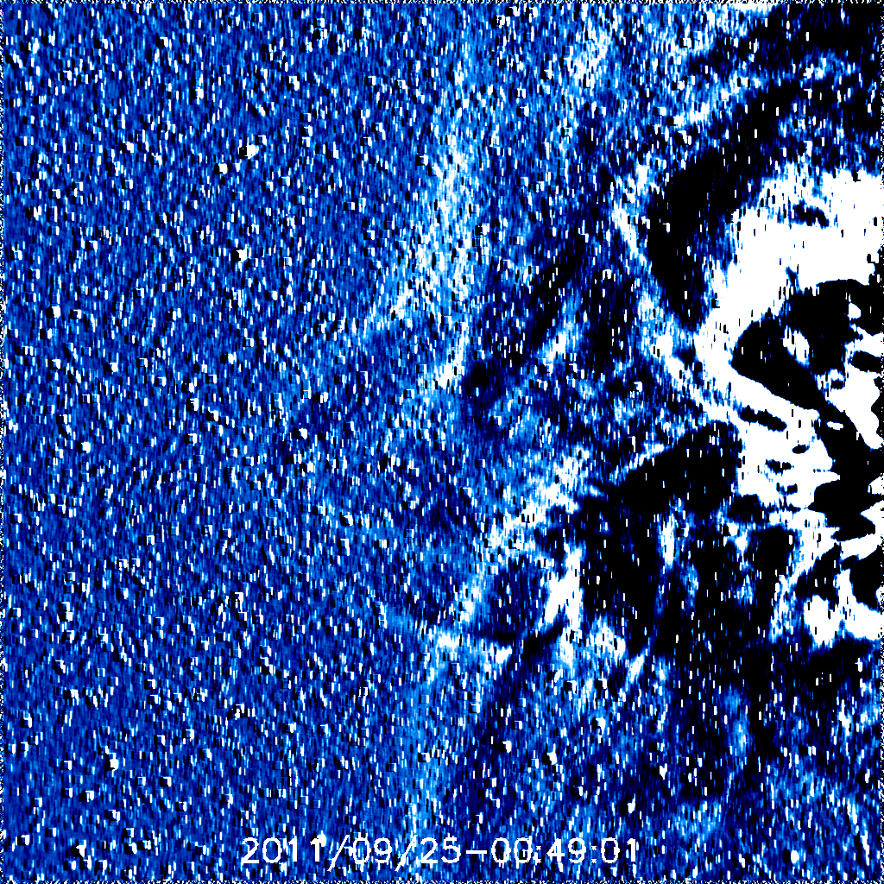

Slide 22
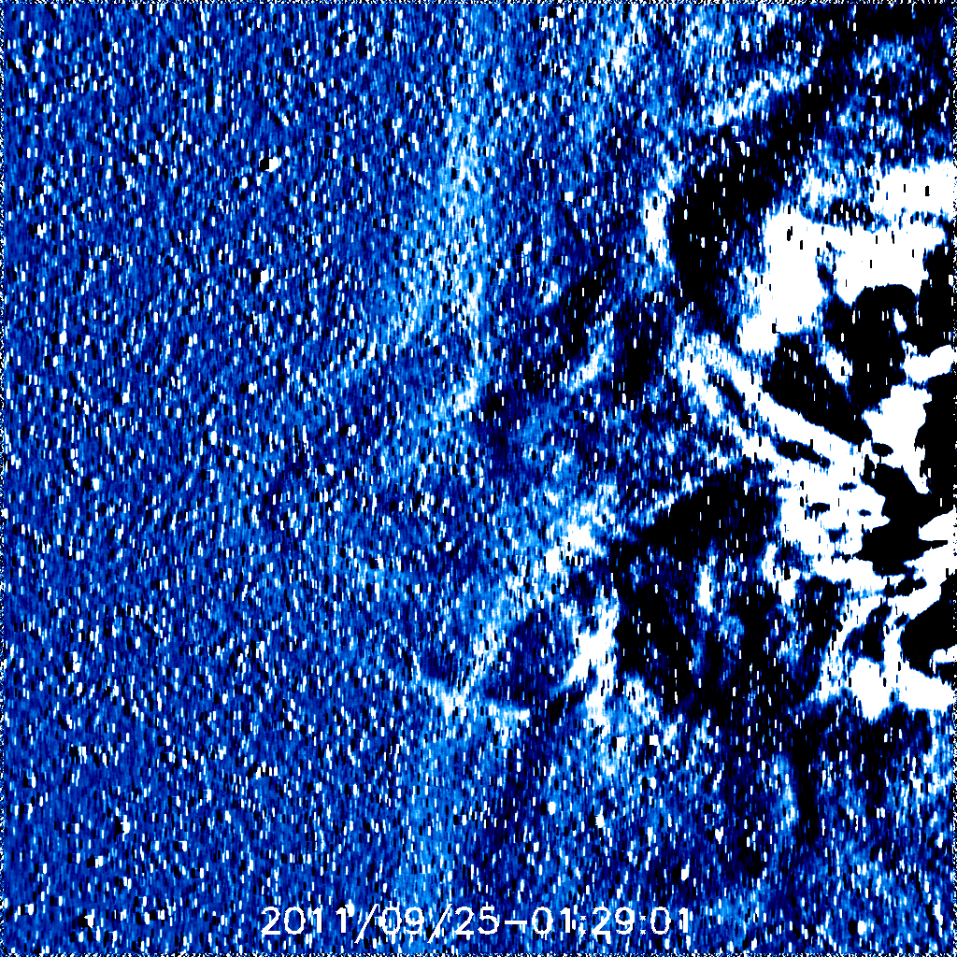

Slide 23
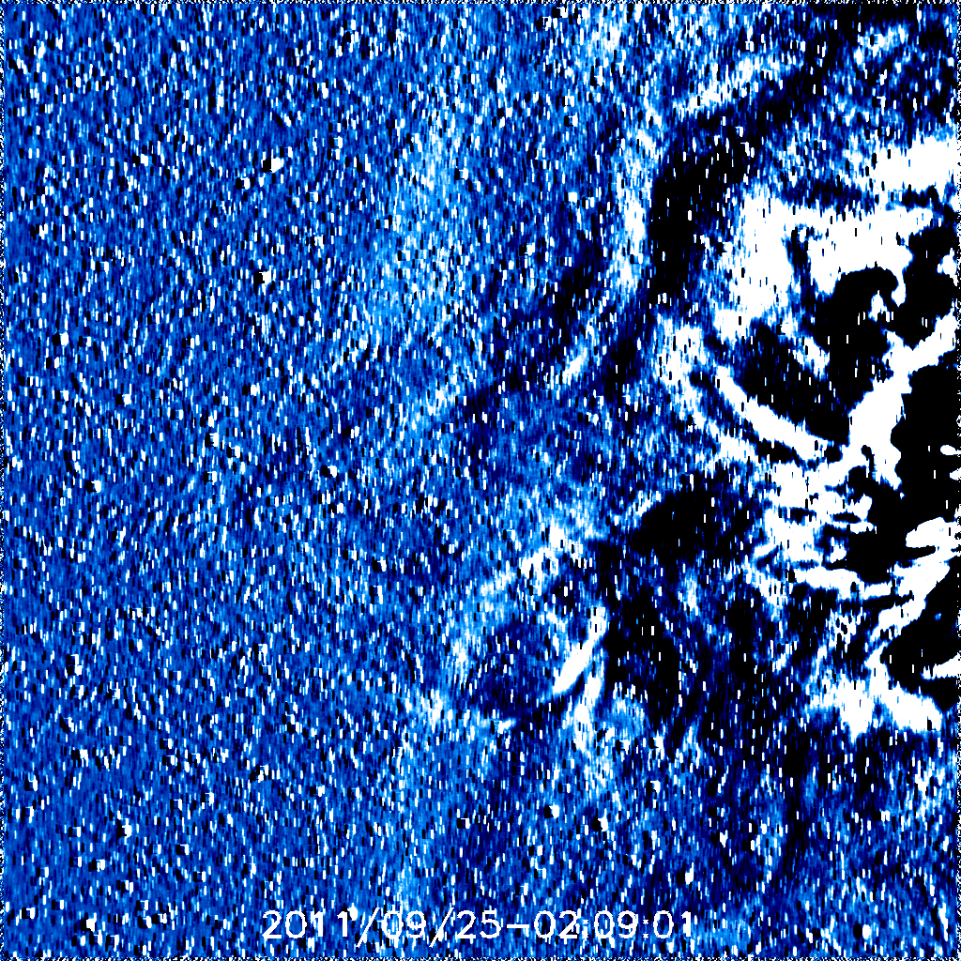
02:09

Slide 24
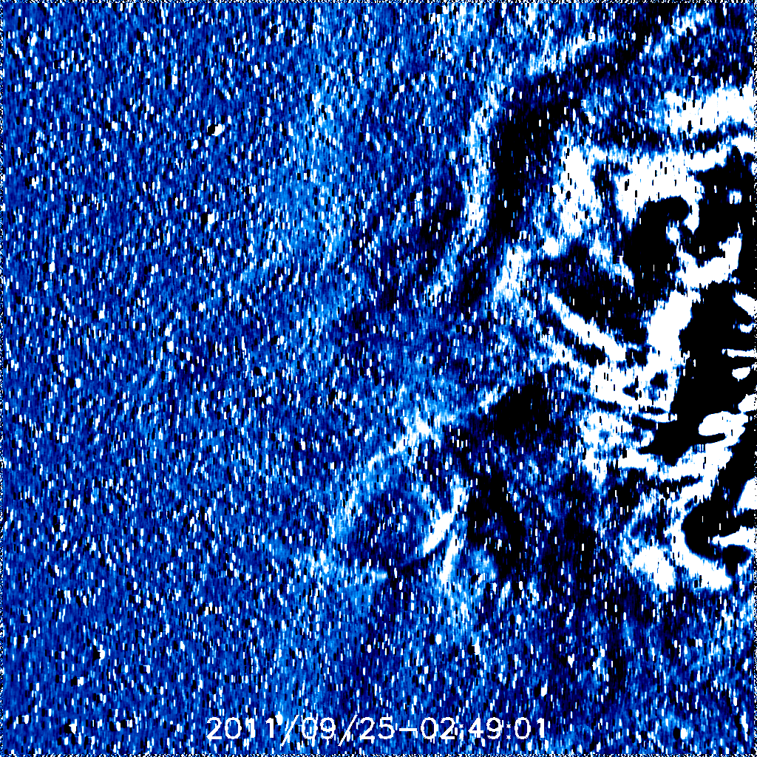
02:49

Slide 25
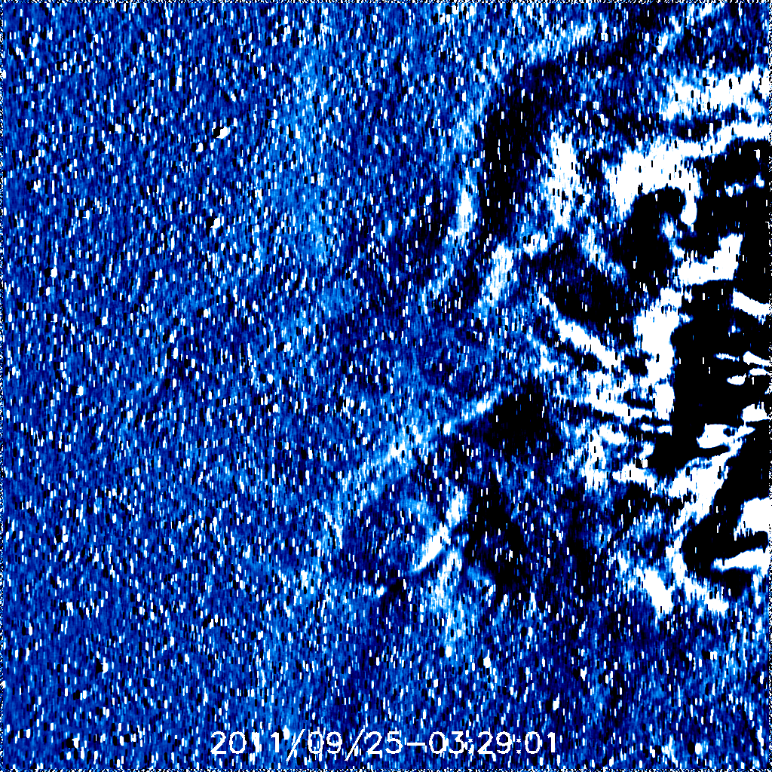

Slide 26
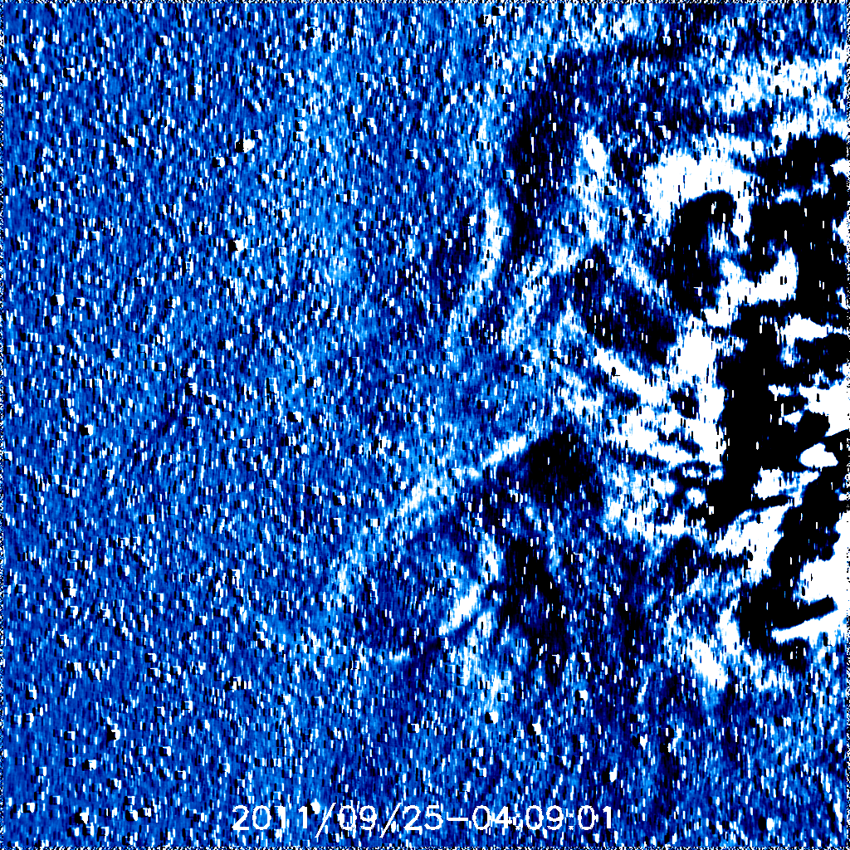

Slide 27
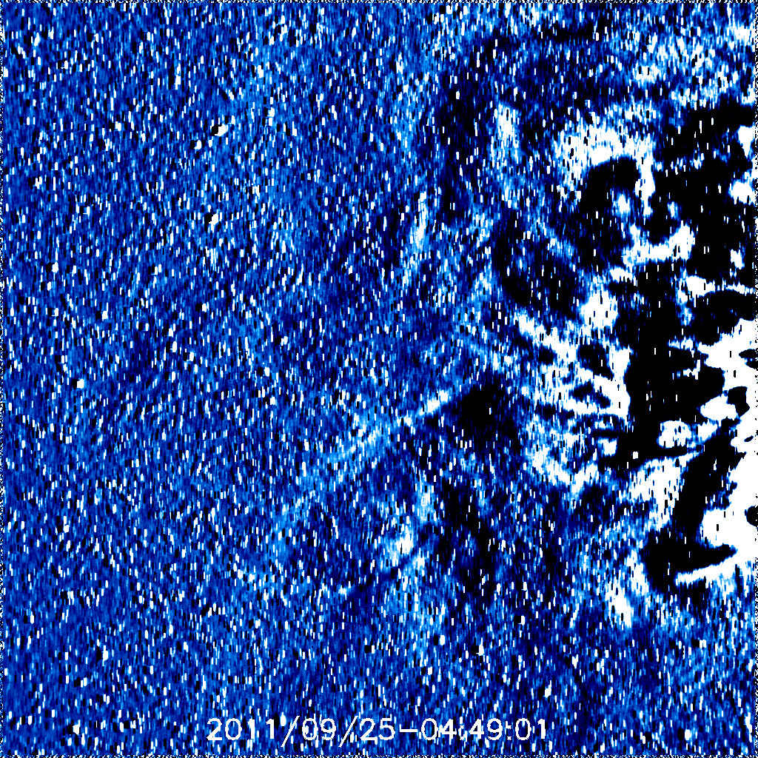

Slide 28
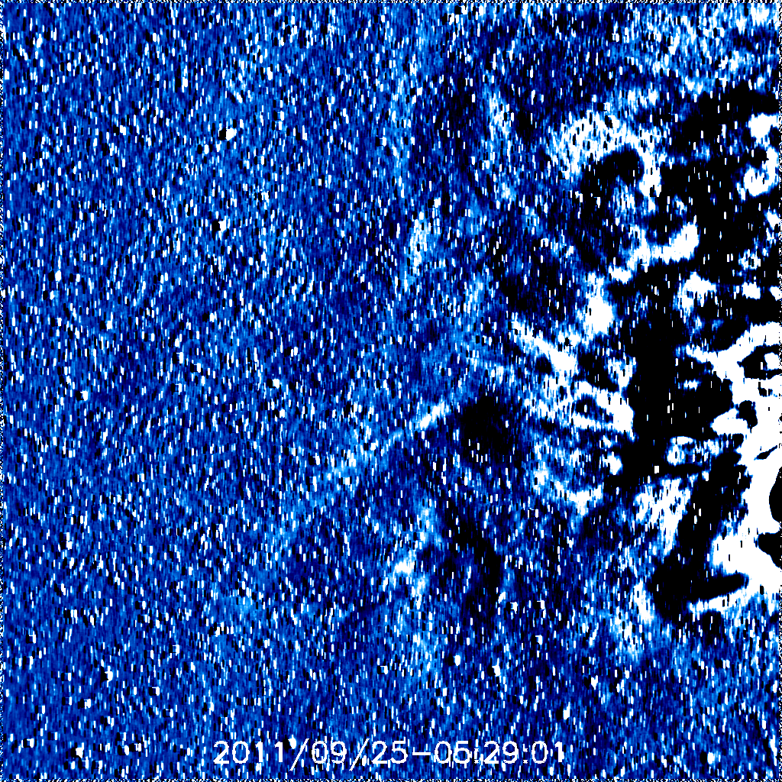

Slide 29
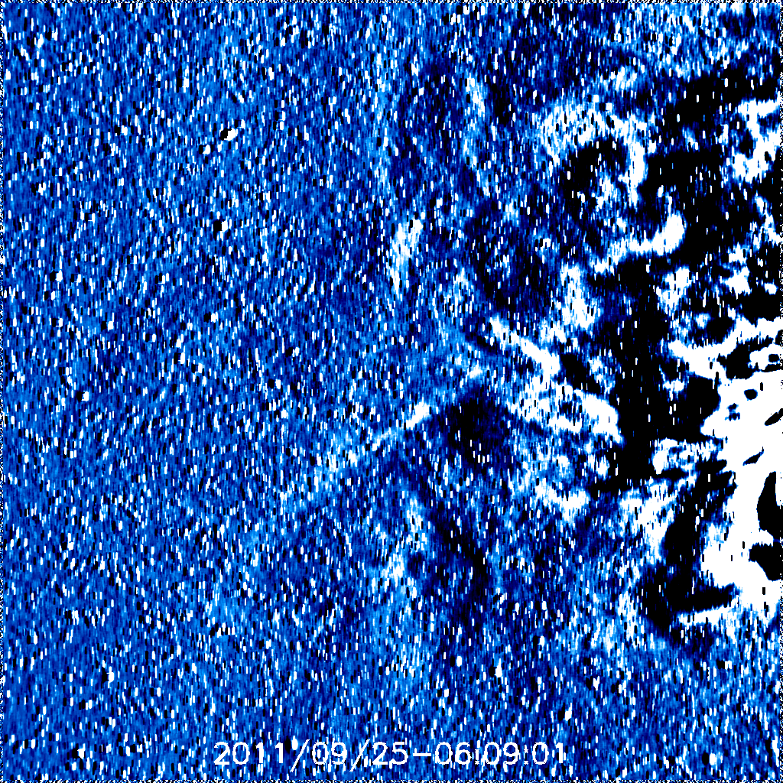

Slide 30
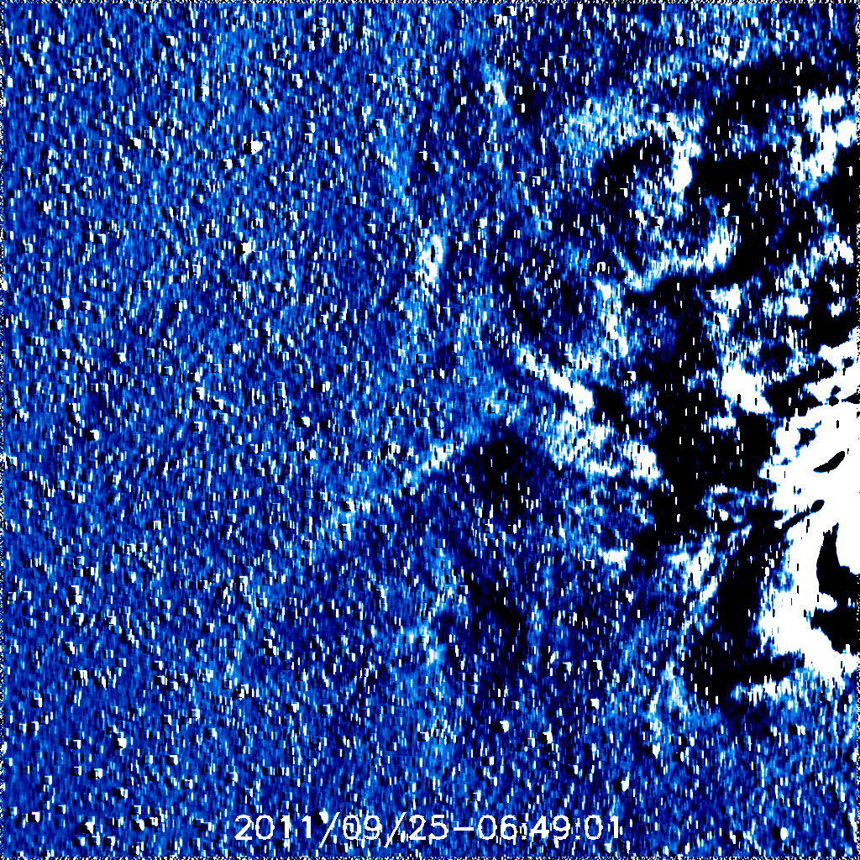

Slide 31
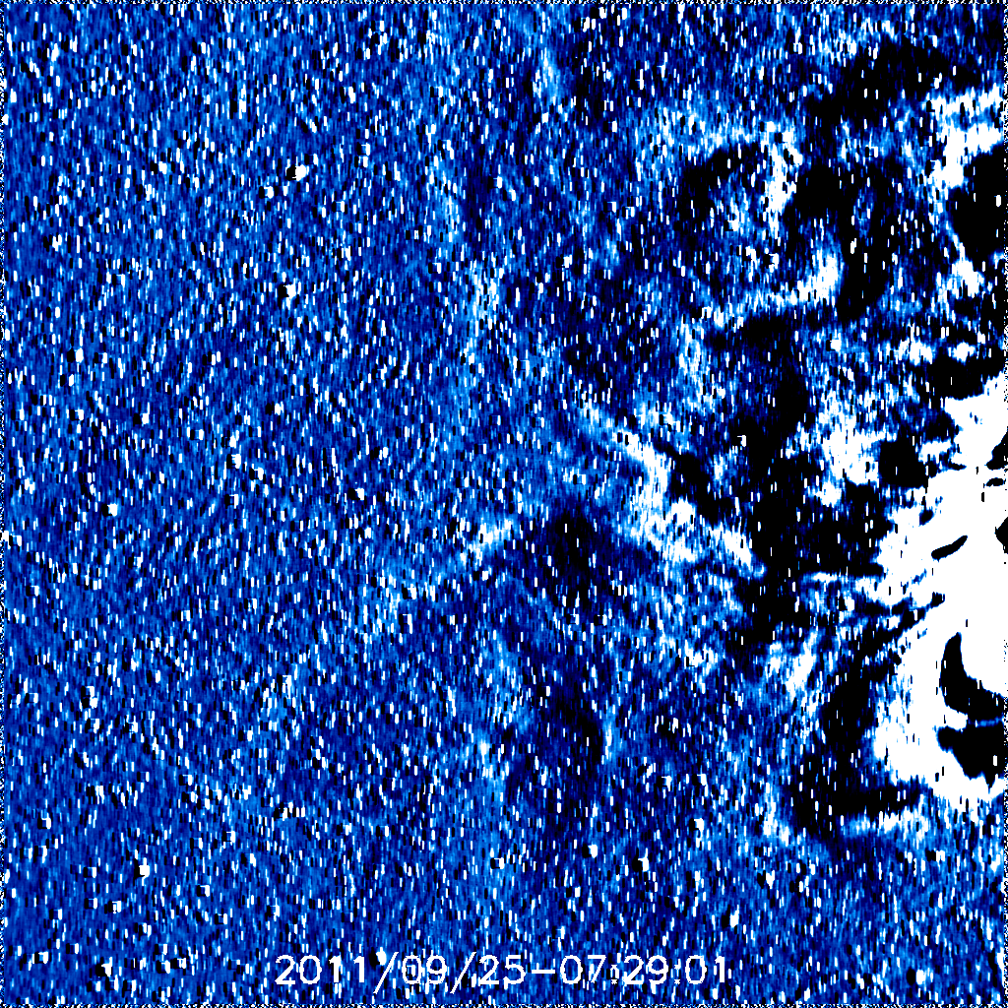

Slide 32
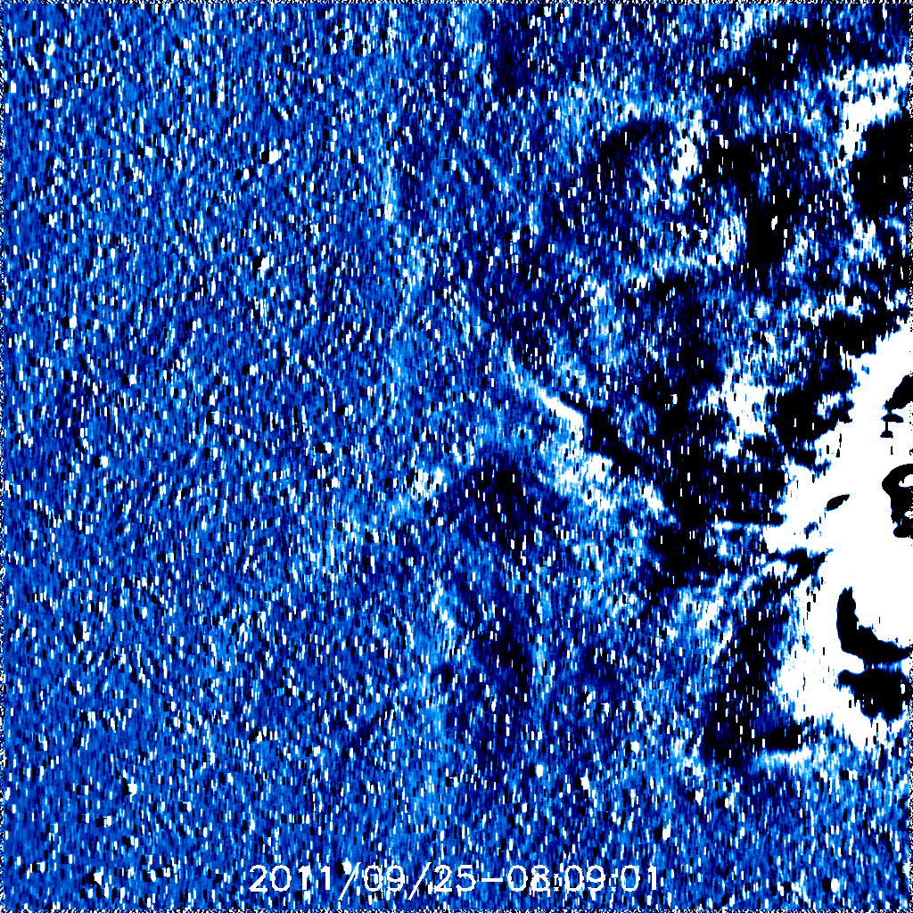

Slide 33
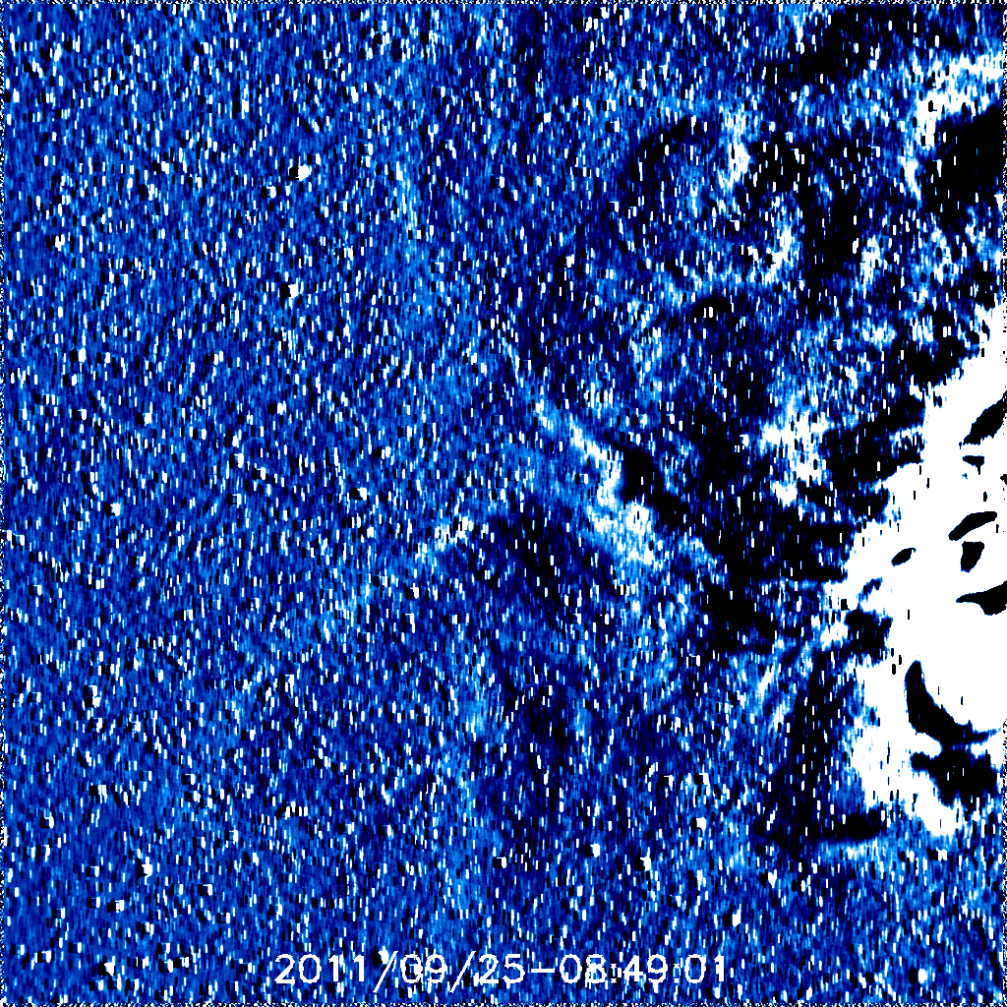
08:49
08:49

Slide 34
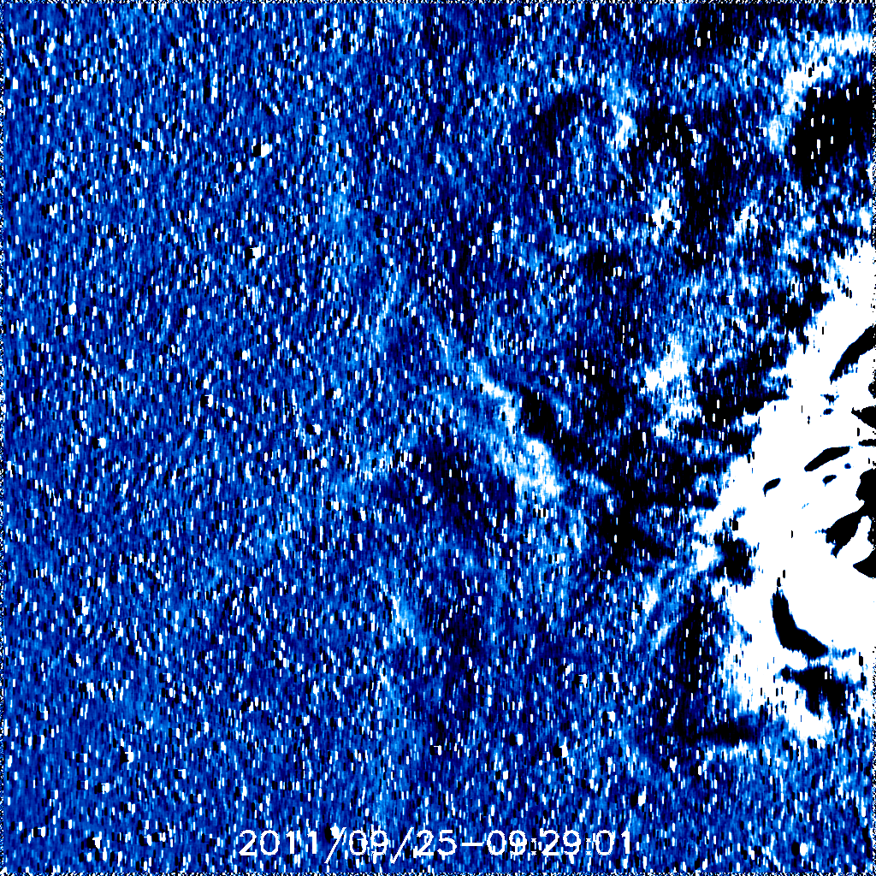

Slide 35
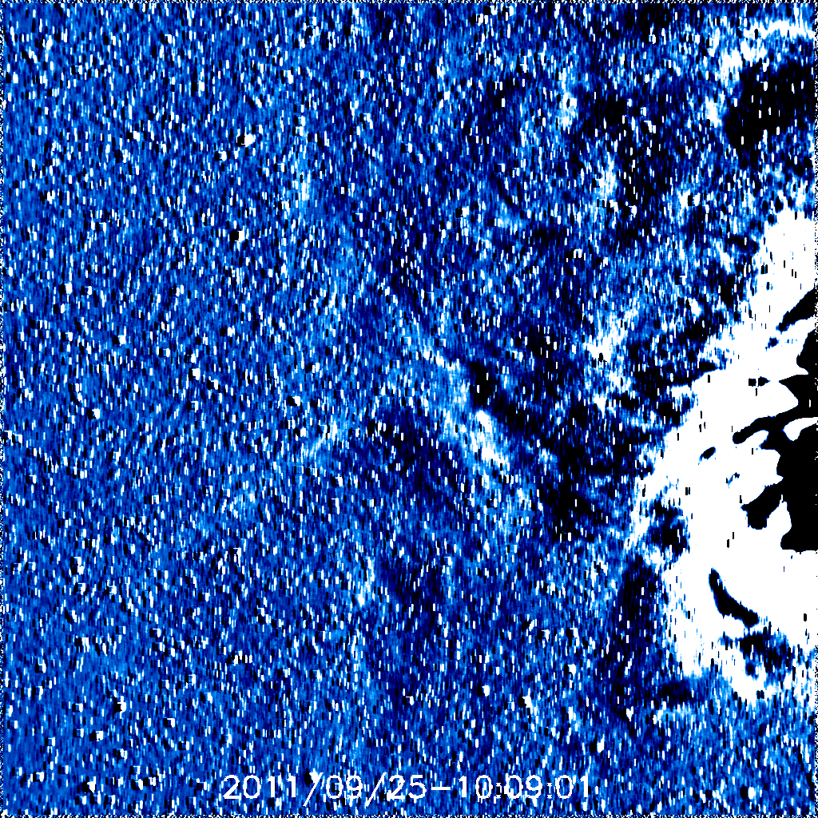

Slide 36
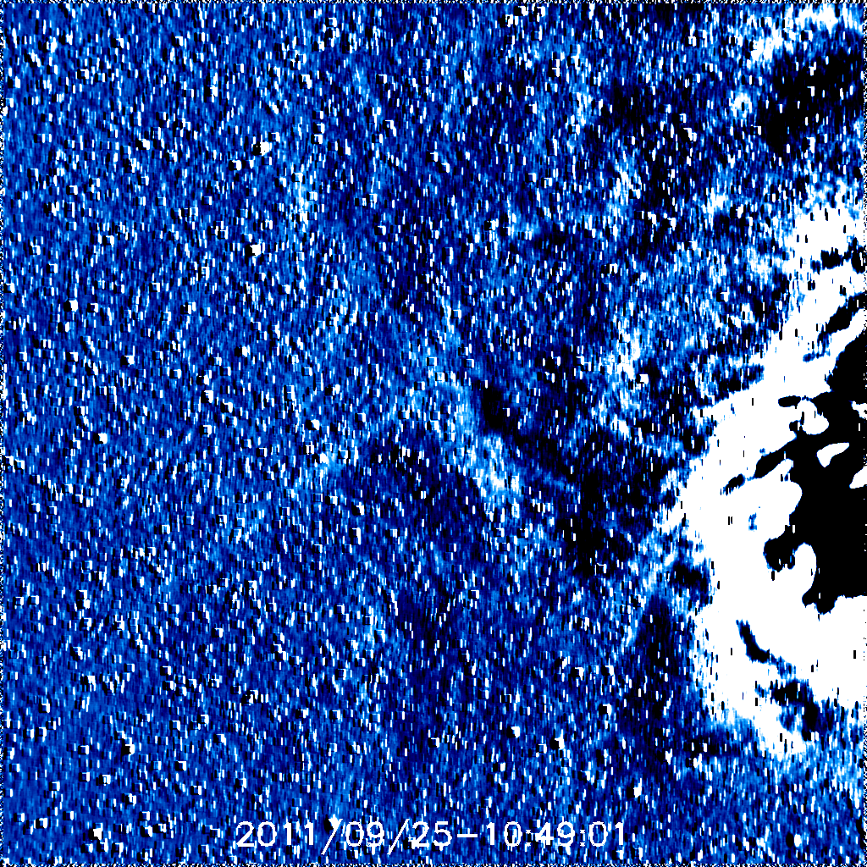

Slide 37
19:36UT ???? Southern Hemisphere
AU | Leading Edge time (Equator) | Leading Edge time
0.0725 | 06:49 | 06:09
0.1675 | 12:49 | 12:09
0.2475 | 20:49 | 19:29
0.33 | 04:49 | 02:09
0.4125 | 12:09 | 08:49

Slide 40
06:09

Slide 41
06:49

Slide 48
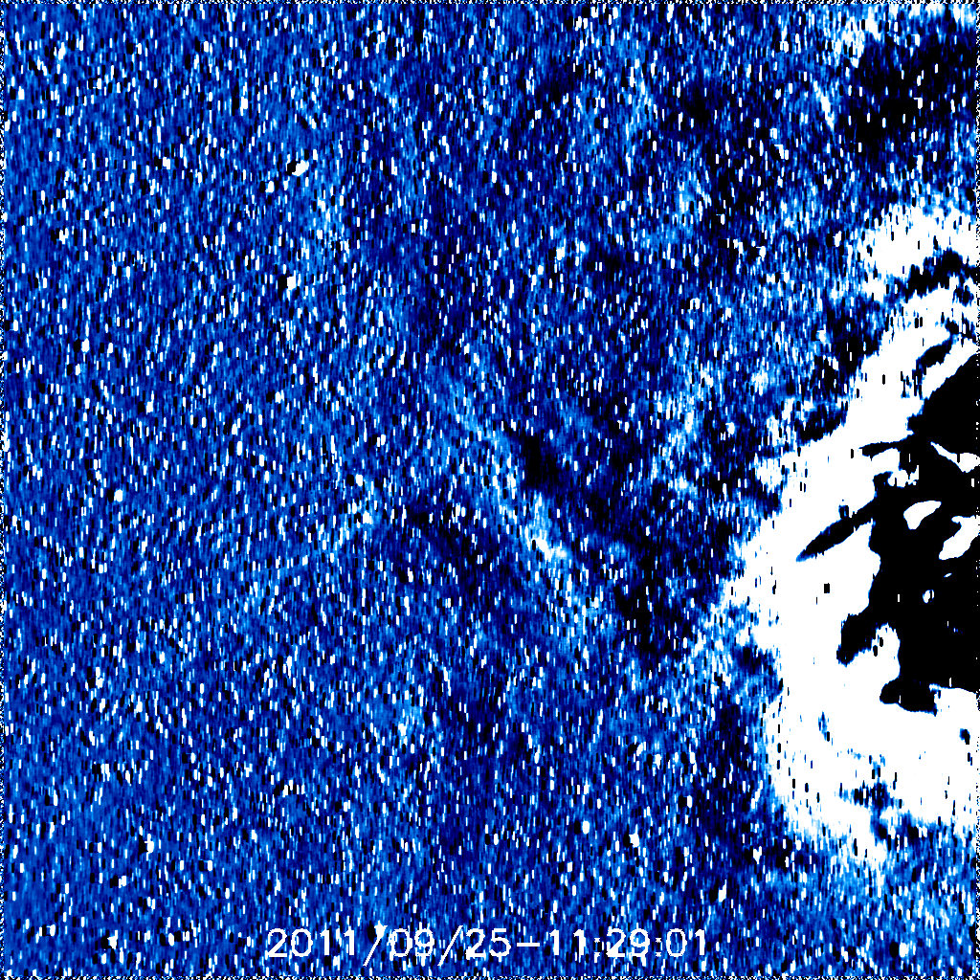

Slide 49
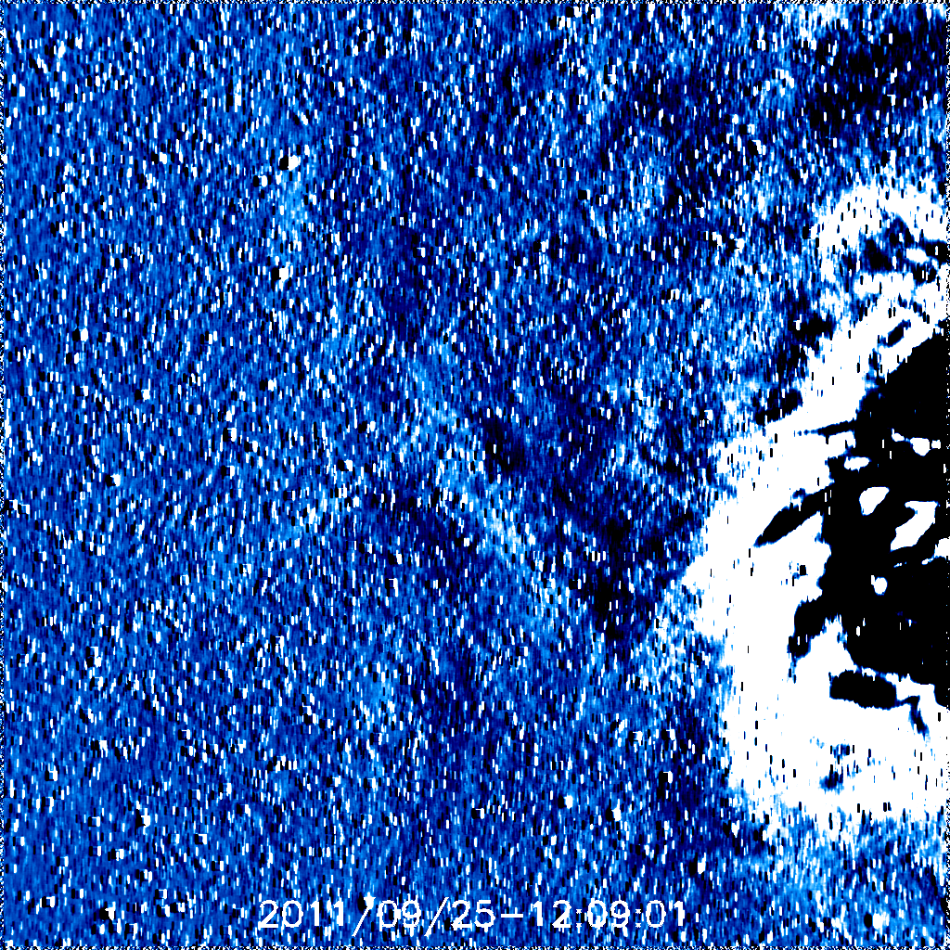
12:09

Slide 50
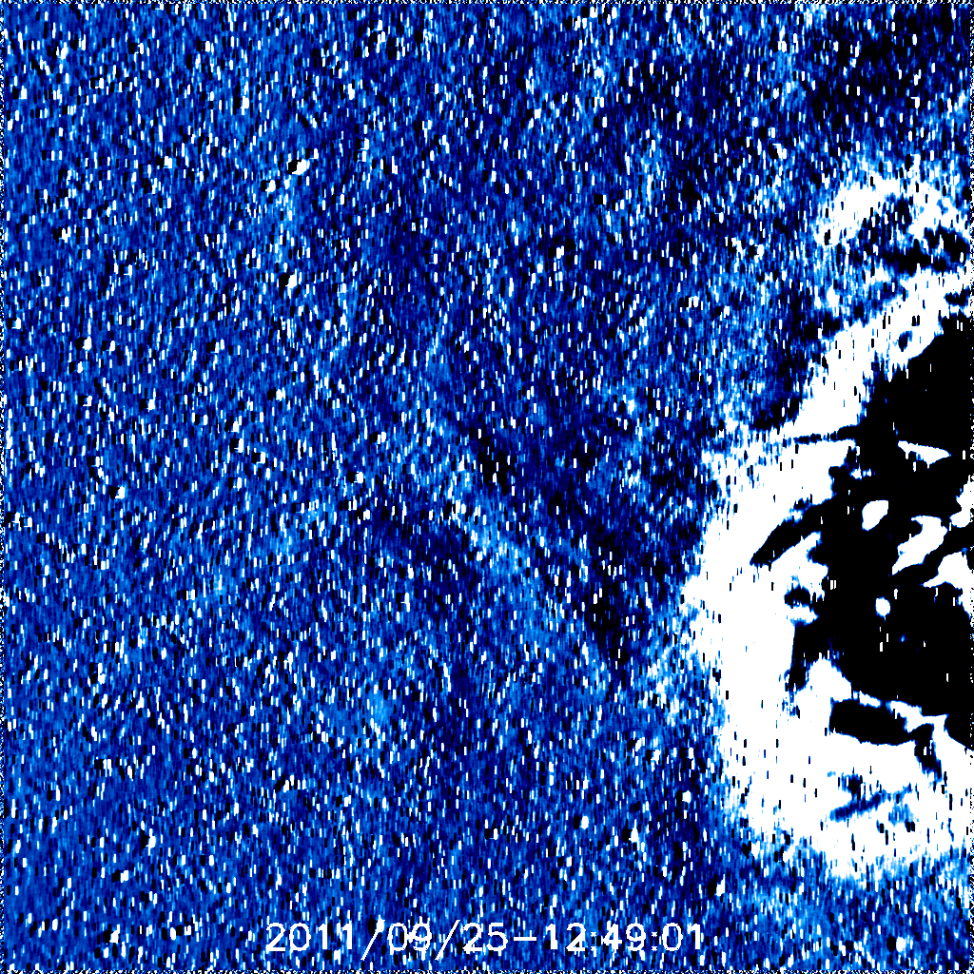
12:49

Slide 51
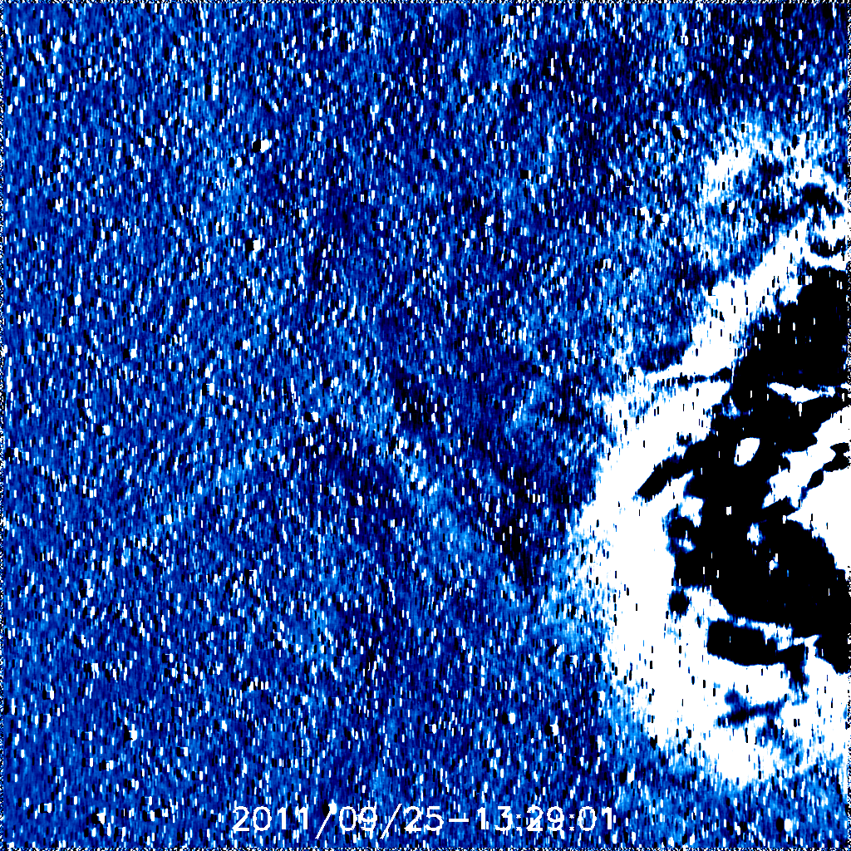

Slide 52
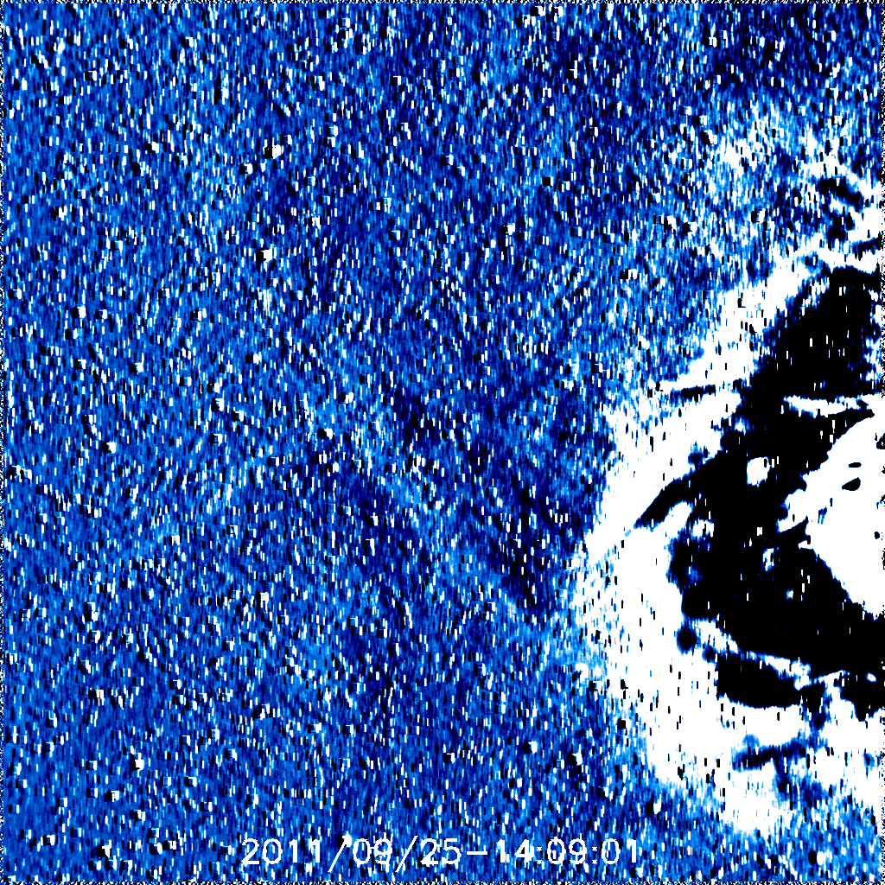

Slide 53
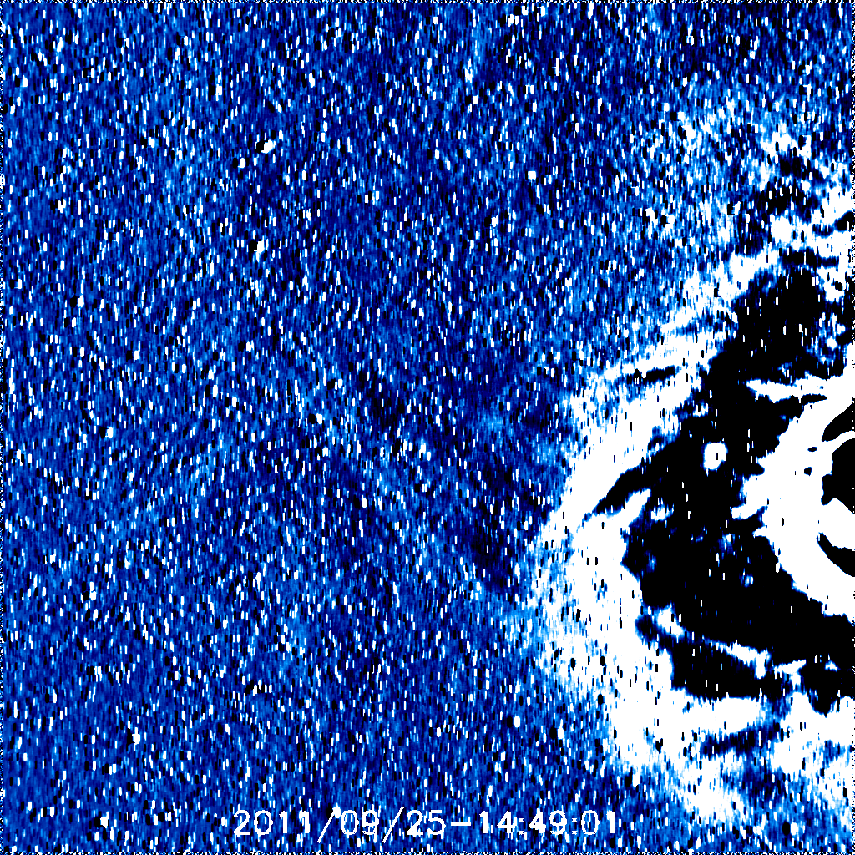

Slide 54
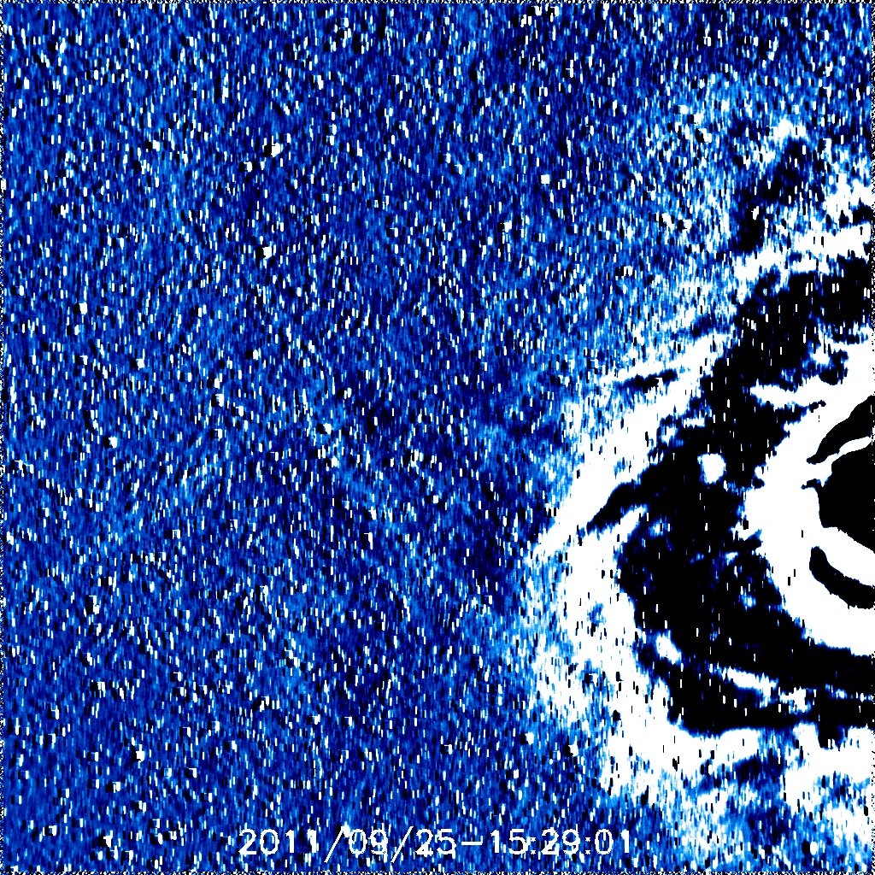

Slide 55
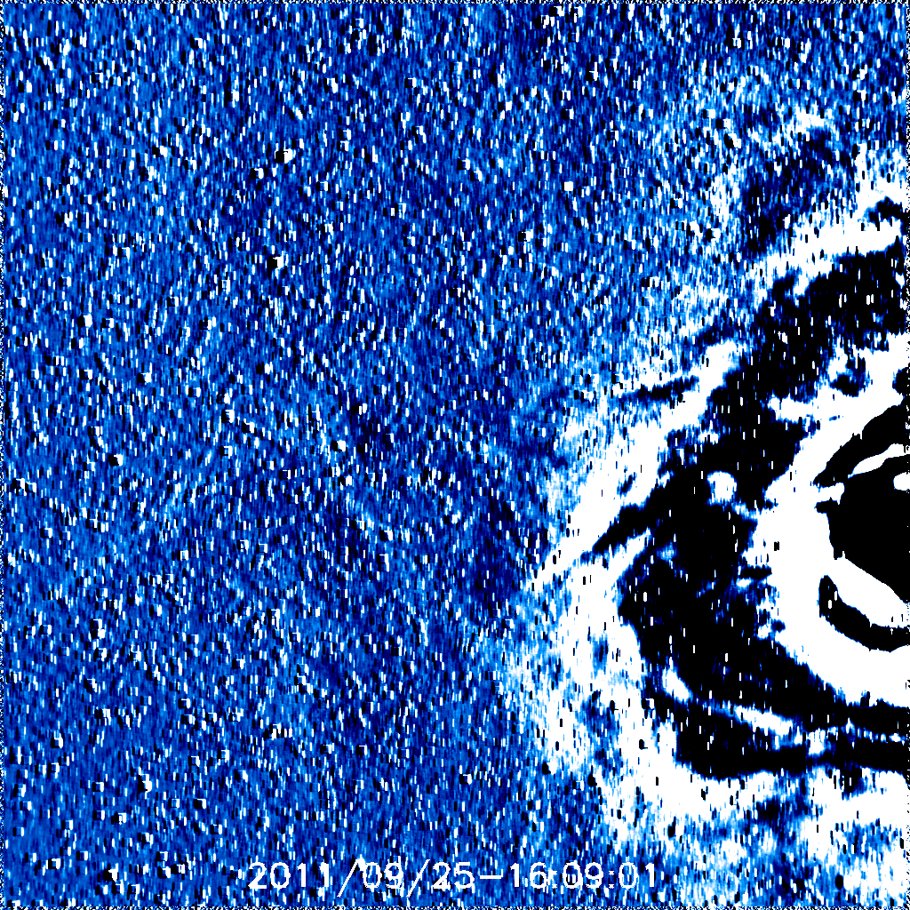

Slide 56
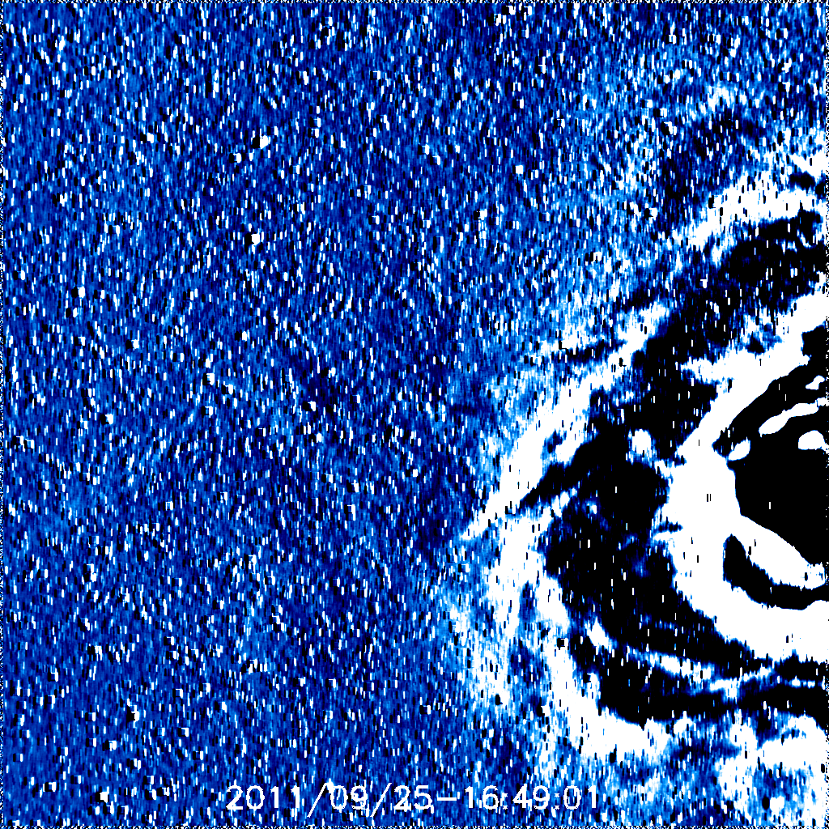

Slide 57
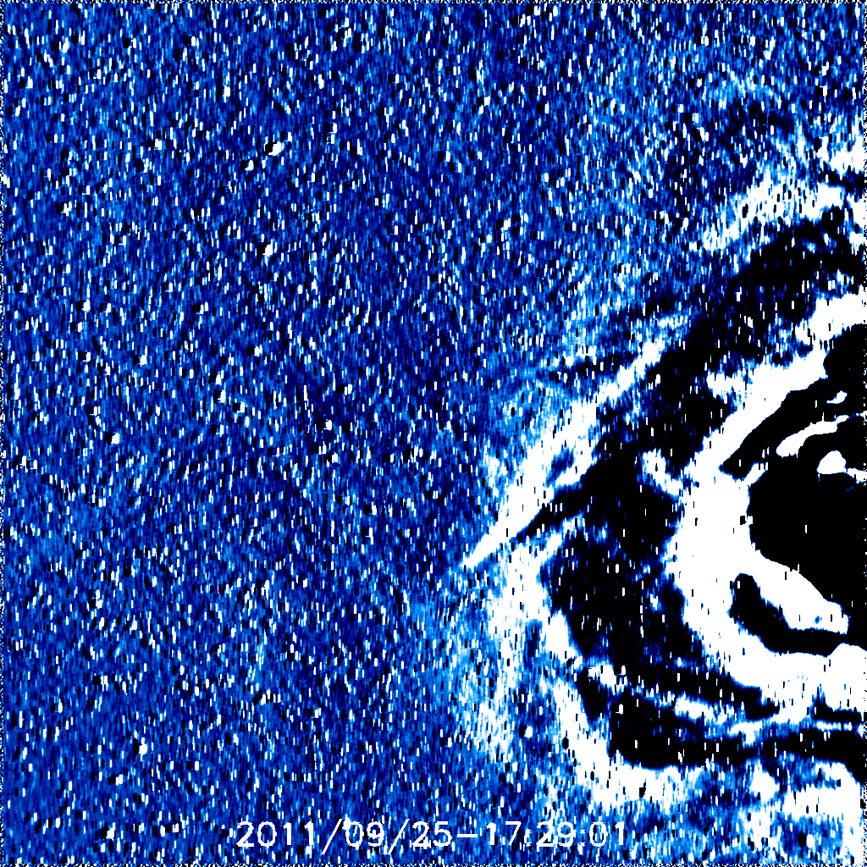

Slide 58
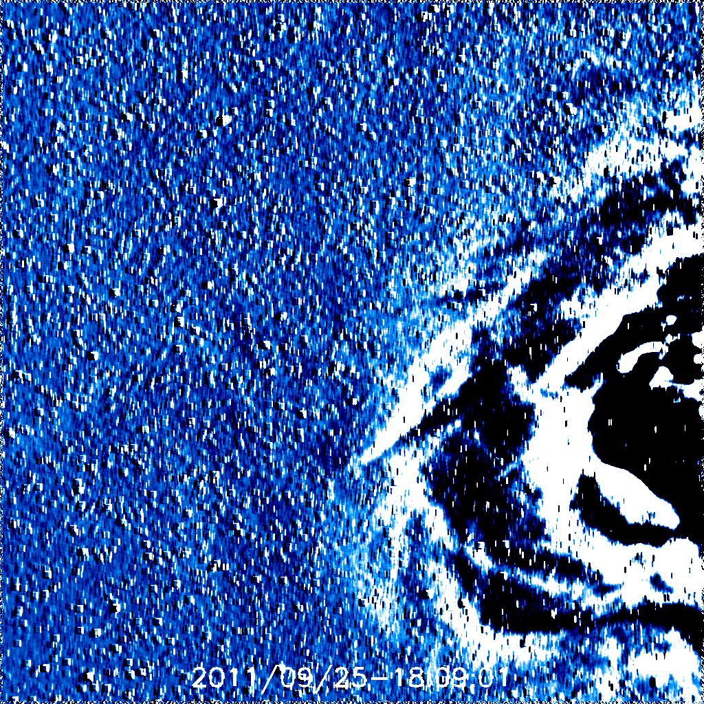

Slide 59
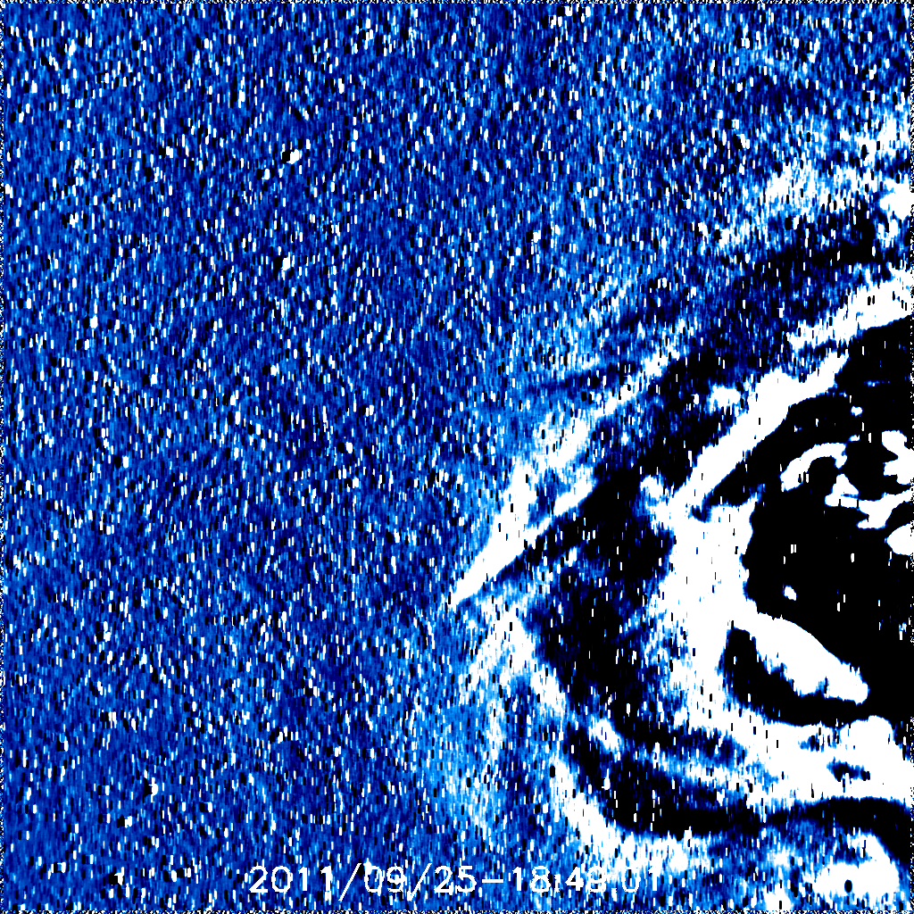

Slide 60
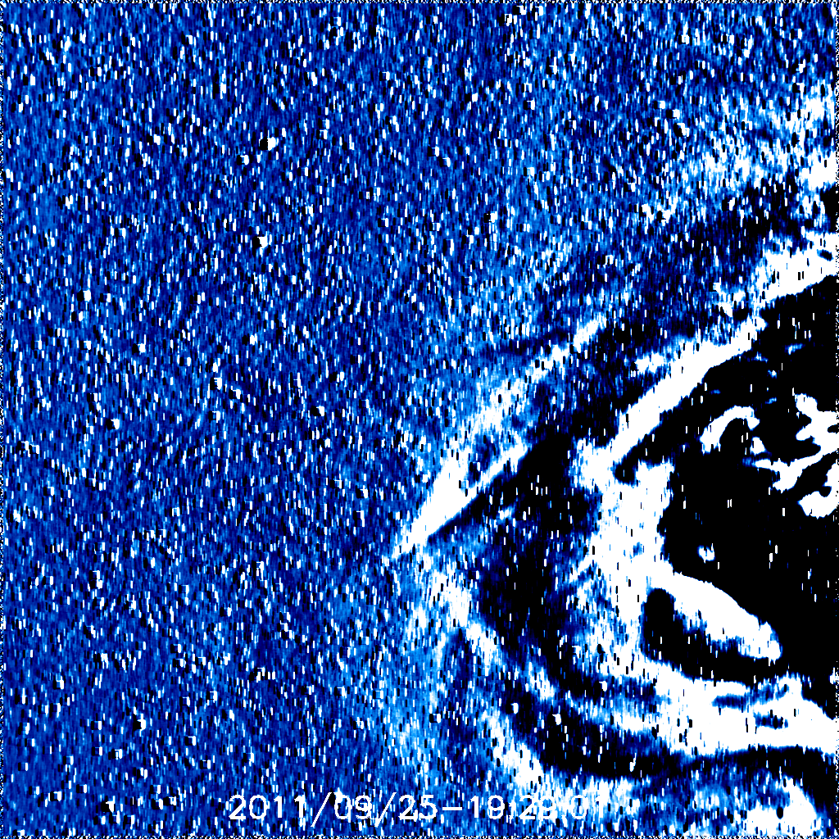
19:29

Slide 61
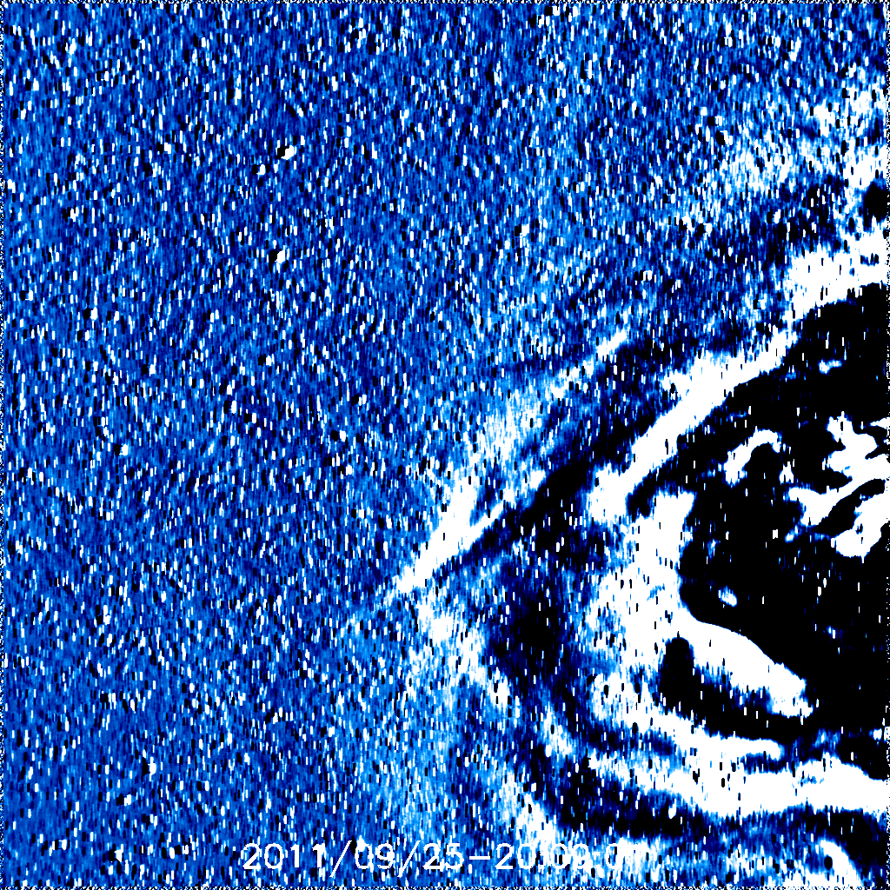

Slide 62
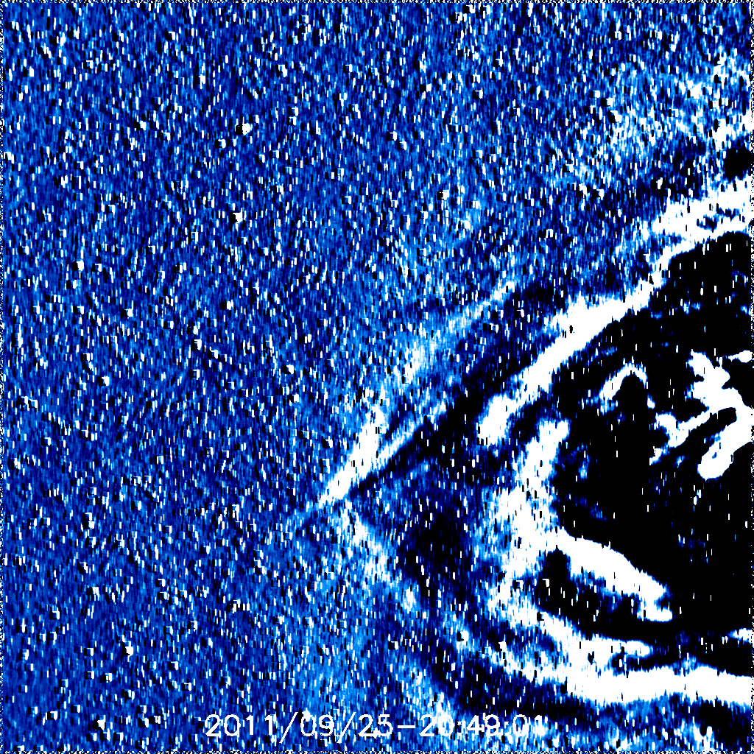
20:49

Slide 70
02:09

Slide 74
04:49

Slide 80
08:49

Slide 85
12:09

Slide 87
CME-2: 19:36UT Northern hemisphere
AU | Leading Edge time (Equator)
0.0725 | 9/24 21:29
0.1675 | 9/25 03:29
0.2475 | 9/25 11:29
0.33 | 9/25 20:09
0.4125 | 9/26 04:09

Slide 90
21:29

Slide 99
03:29

Slide 111
11:29

Slide 124
20:09

Slide 136
04:09

