Slide 1
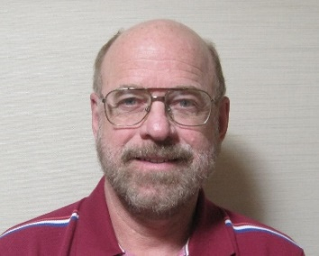
Heliospheric Mesoscale 3-D Reconstructions and the
UCSD Plan for the NASA Small Explorer PUNCH Analyses
Bernard Jackson (bvjackson@ucsd.edu)
Matthew Bracamontes, Benjamin Pieczynski, Andrew Buffington
Department of Astronomy and Astrophysics, University of California,
San Diego, 9500 Gilman Drive, La Jolla, CA 92093-0424, USA
http://ips.ucsd.edu/ http://stereo.ucsd.edu/

Slide 2
Introduction:
The UCSD time-dependent 3D reconstruction analysis – Interplanetary Scintillation (IPS)
Analysis modification to provide very high resolution Thomson scattering pseudo brightness and polarization brightness:
SMEI, STEREO A HI’s, Parker Probe (New), PUNCH (Future)
More
Notes:
Introduction

Slide 3
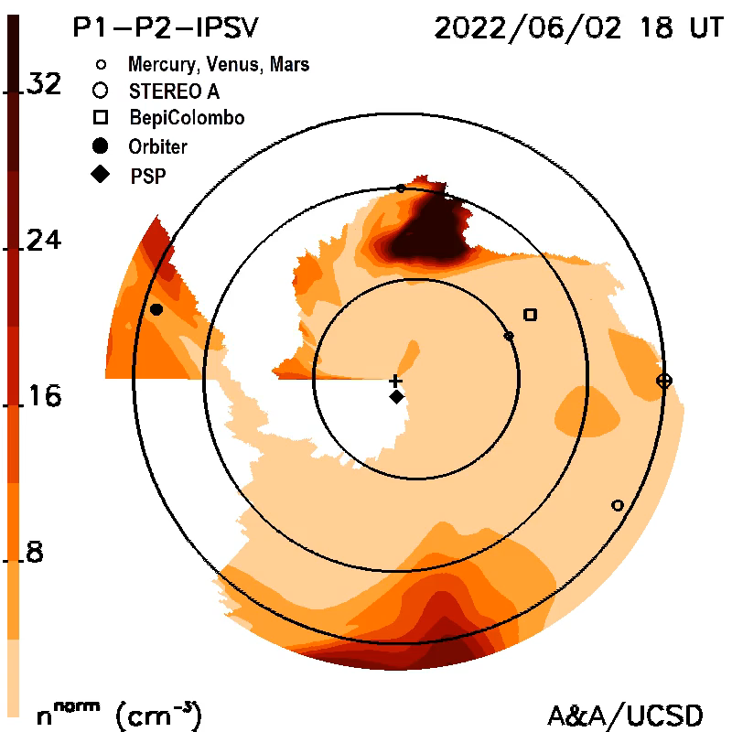
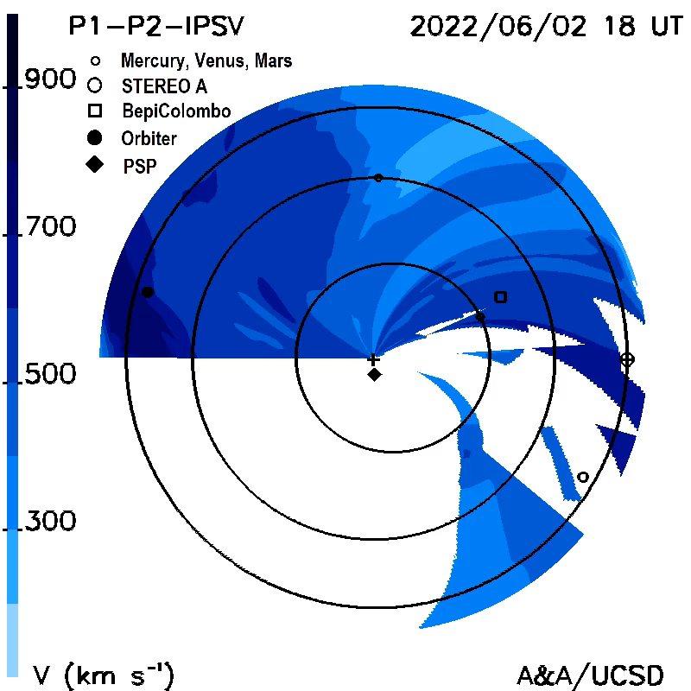
Parker WISPR 3-D reconstructions of a June 2, 2022, CME
New (3 weeks)
Parker
Parker
Parker
WISPR Density Ecliptic Cut IPS Velocity Cut

Slide 4
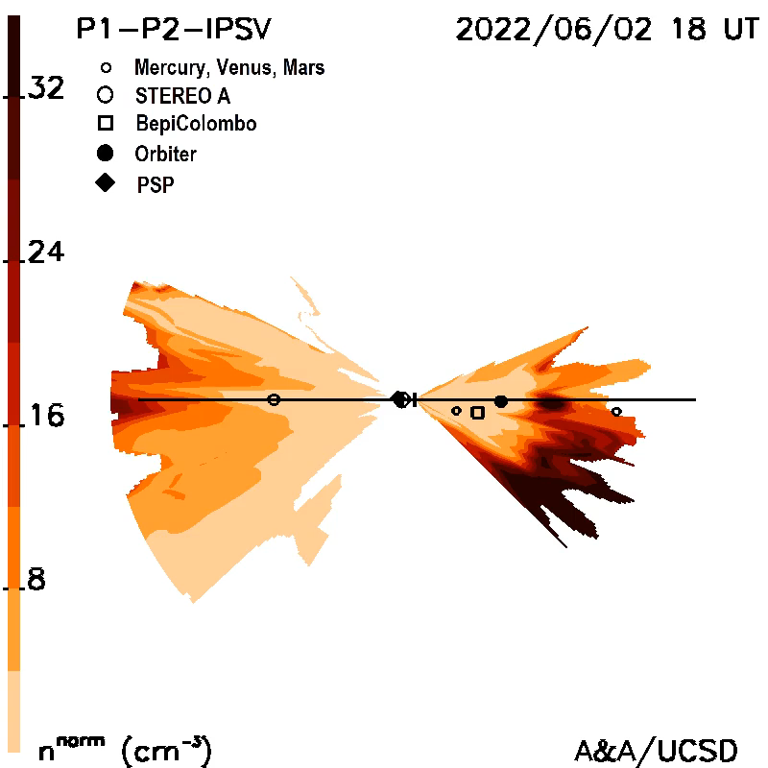
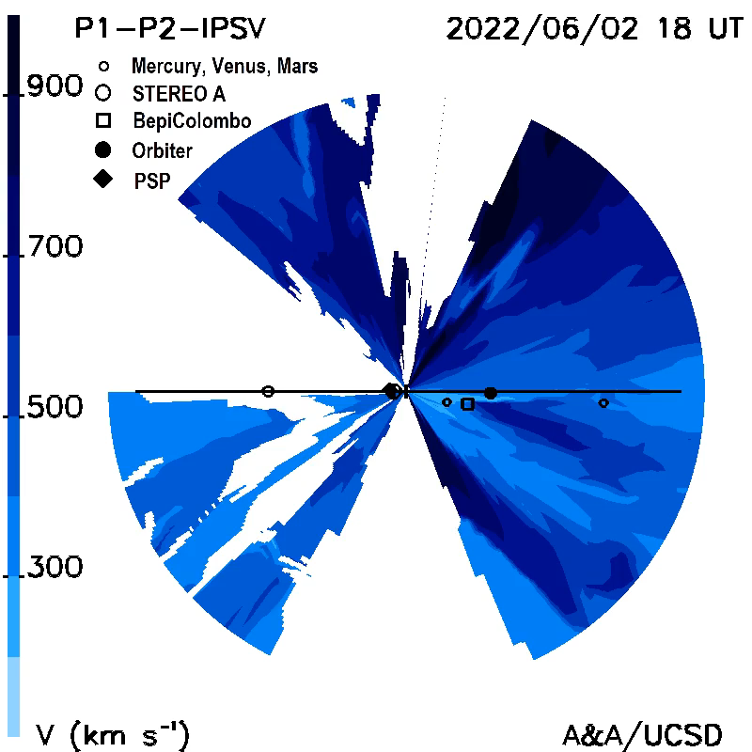
Parker WISPR 3-D reconstructions of a June 2, 2022, CME
Parker
Parker
WISPR Meridional 90⁰ in Front of Parker Cut IPS 90⁰ Velocity Cut

Slide 5
Conclusion:
The UCSD time-dependent 3D reconstruction analysis – Interplanetary Scintillation (IPS)
Analysis modification to provide very high resolution Thomson scattering pseudo brightness and polarization brightness:
SMEI, STEREO A HI’s, Parker Probe (New), PUNCH (Future)
More
Notes:
Introduction

