Slide 1
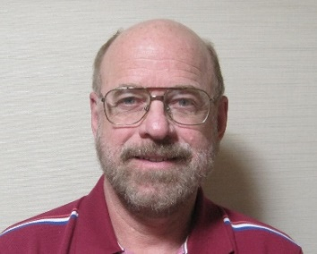
Heliospheric Mesoscale 3-D Reconstructions and the
UCSD Plan for the NASA Small Explorer PUNCH Analyses
Bernard Jackson (bvjackson@ucsd.edu)
Matthew Bracamontes, Benjamin Pieczynski, Andrew Buffington
Department of Astronomy and Astrophysics, University of California,
San Diego, 9500 Gilman Drive, La Jolla, CA 92093-0424, USA
http://ips.ucsd.edu/ http://stereo.ucsd.edu/

Slide 2
Introduction:
The UCSD time-dependent 3D reconstruction analysis – Interplanetary Scintillation (IPS)
Analysis modification to provide very high resolution Thomson scattering pseudo brightness and polarization brightness:
SMEI, STEREO A HI’s, Parker Probe (New), PUNCH (Future)
More
Notes:
Introduction

Slide 3
IPS Analyses

Slide 4
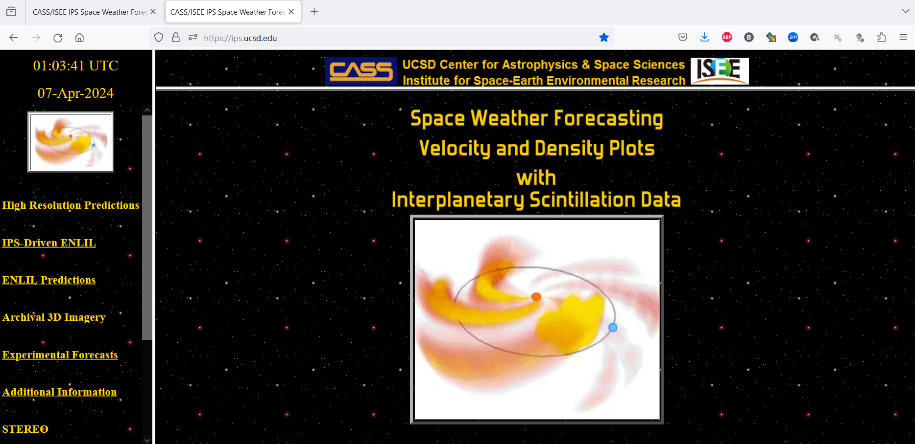
Heliospheric Mesoscale 3-D Reconstructions and the
UCSD Plan for the NASA Small Explorer PUNCH Analyses
Bernard Jackson (bvjackson@ucsd.edu)
Matthew Bracamontes, Benjamin Pieczynski, Andrew Buffington
Department of Astronomy and Astrophysics, University of California,
San Diego, 9500 Gilman Drive, La Jolla, CA 92093-0424, USA
http://ips.ucsd.edu/ http://stereo.ucsd.edu/

Slide 5
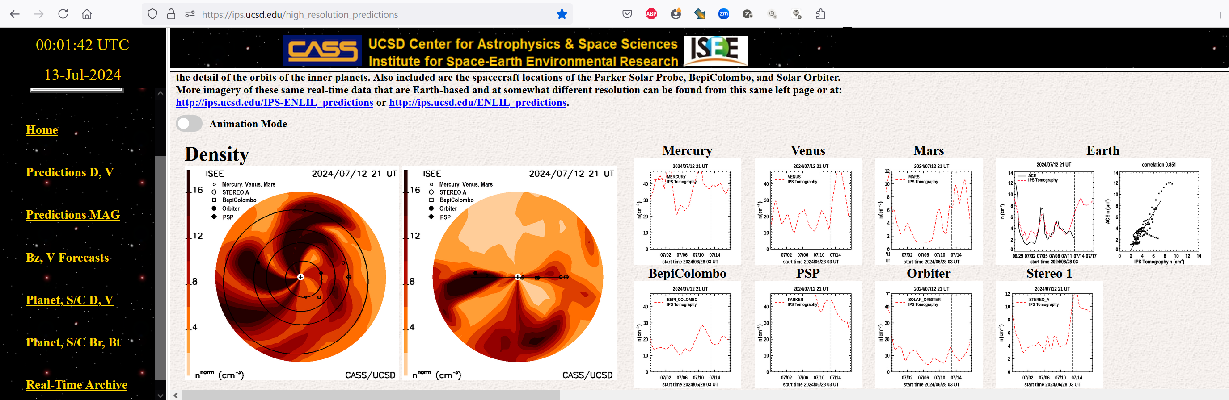
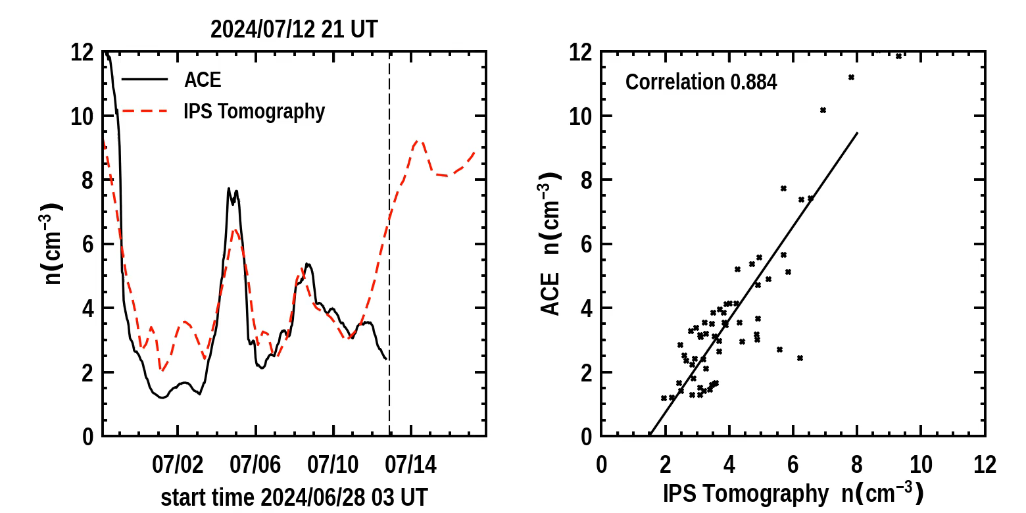
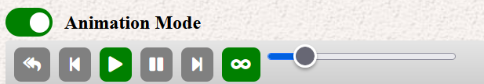
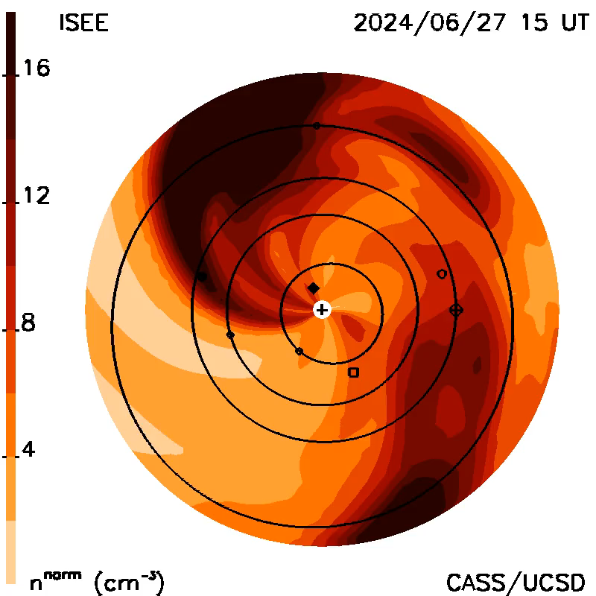
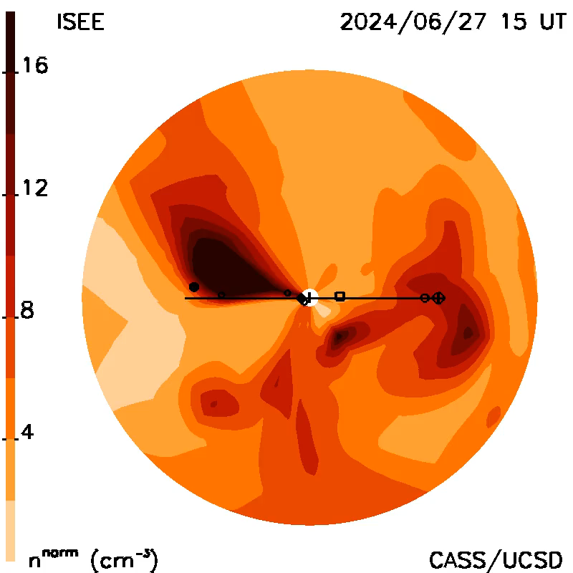
Jackson, B.V., et al., 2011, Adv. in Geosciences, 30, 93-115; Jackson et al., 2023, Solar Phys., 258, 151-165
https://ips.ucsd.edu/ or https://ips.ucsd.edu/high_resolution_predictions/
2024 July 12 at 21 UT
Web analysis runs “automatically” using Linux on a P.C.
See Jackson et al., 2023, Solar Phys., 298 (74), doi: 10.1007/s11207-023-02169-8.
Notes:
UCSD has predicted and forecast background and CME on different websites around the world using a variety of visualizations. Here we show the location of various inner heliospheric spacecraft and the values of density and velocity at each. Hovering over the various in-situ analyses at each location allows a better view of each time series.

Slide 6
Thomson Scattering
B Analyses

Slide 7
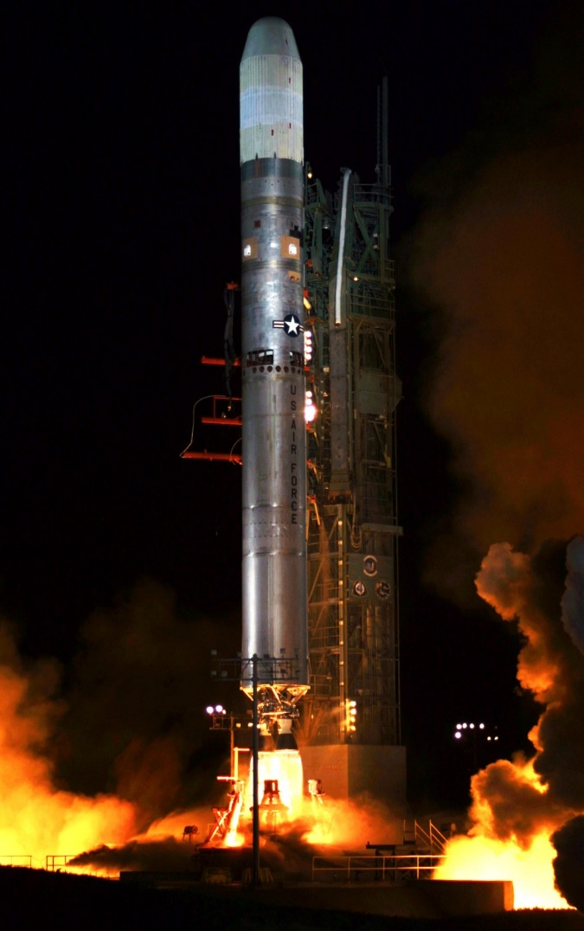
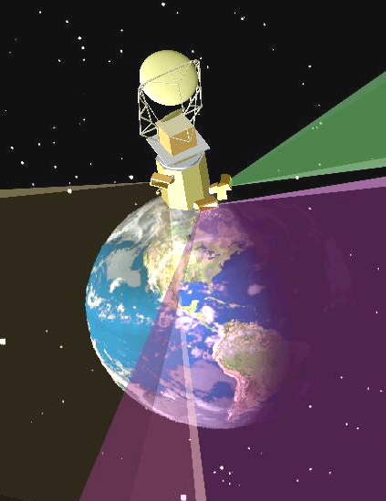
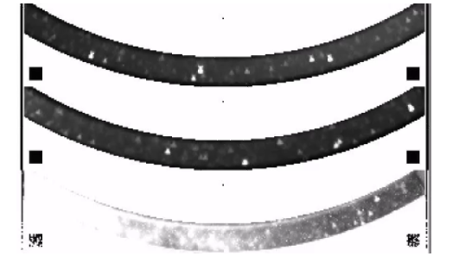
The Solar Mass Ejection Imager (SMEI)
Titan II launch from Vandenberg AFB
6 January 2003.
Jackson, B.V., et al., 2004, Solar Phys., 225, 177
Launch 6 January 2003
Sun
C1
C2
C3
Sun
1 gigabyte/day; total ~4 terabytes
Simultaneous images from the three SMEI cameras.
A joint US Air Force - NASA Project

Slide 8
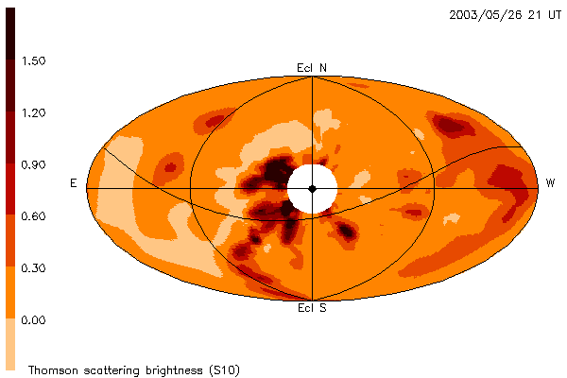
Jackson et al., 2020, Frontiers in Astronomy
and Space Sci., doi: 10.3389/fspas.2020.568429
3,000,000 LoS in one month, 1.5- Hour Cadence Resolution
SMEI Analysis
correlation 0.94 correlation 0.95

Slide 9
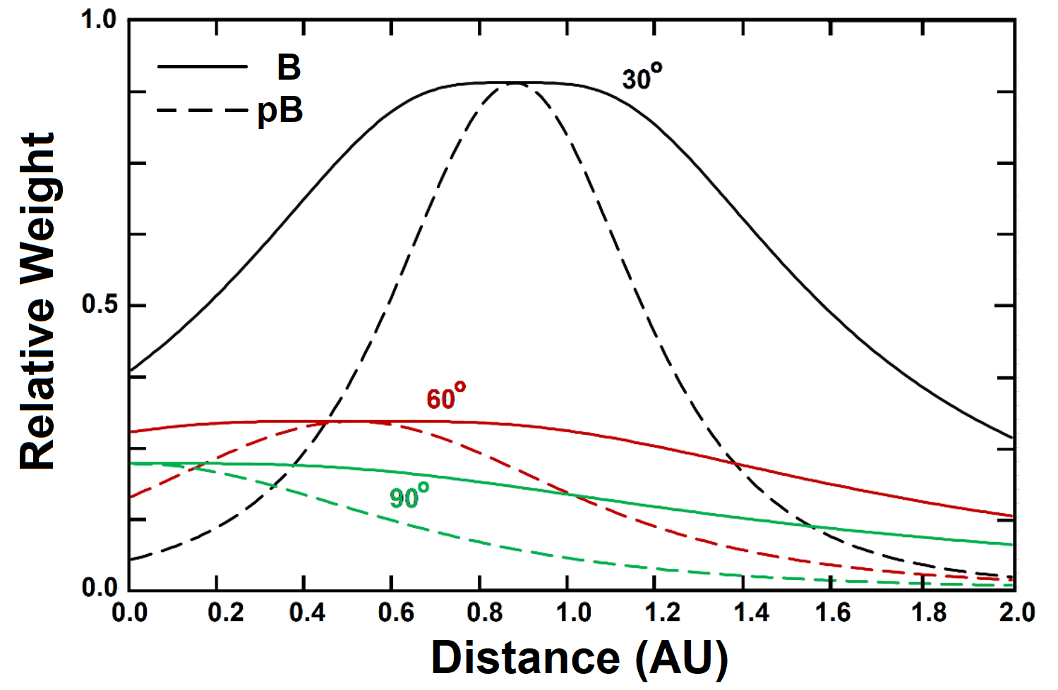
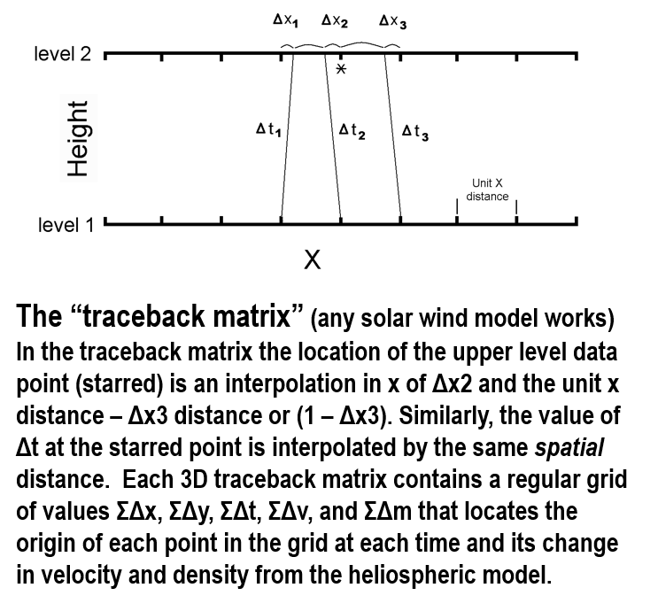
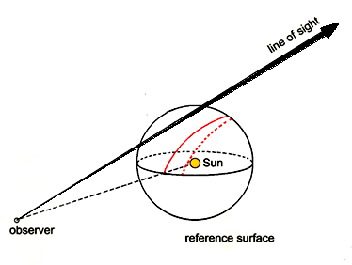
Thomson-Scattering B & pB Line-of-Sight Response
Jackson, B.V., et al., 2008, Adv. in Geosciences 21, 339
Jackson et al., 2020, Frontiers in Astronomy and Space Sci., doi: 10.3389/fspas.2020.568429
Heliospheric C.A.T. analyses:
“Traceback” Matrix Concept
Billings, D.E., 1966, Academic, New York, p.150
Notes:
The analysis of ASHI is designed to fit an existing Computer Assisted Tomography fit to data, Using the known data line of sight (LoS) weighting, and a first guess of densities, an iterated solution model that assumes mass and mass flux conservation can iterated to provide a fit to the brightness observed. As heliospheric structures move outward. To the upper left is the weighting from the Thomson-scattering signal at three different elongations, 30, 60, and 90 degrees. L

Slide 10
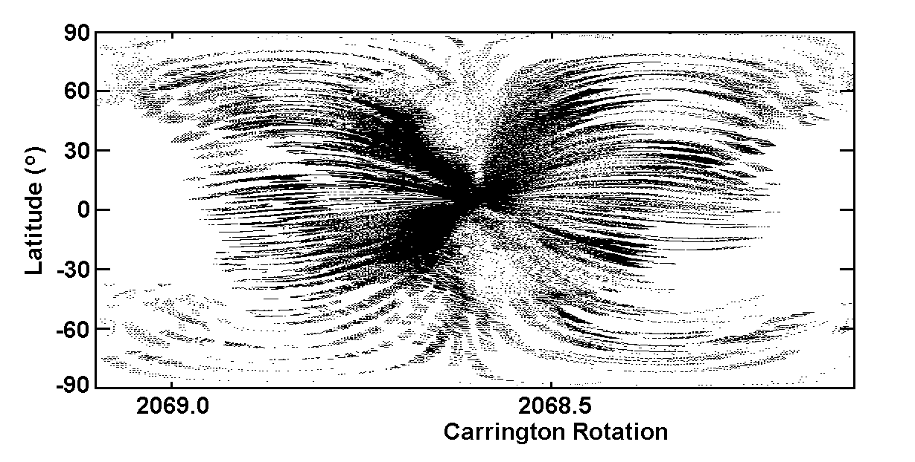
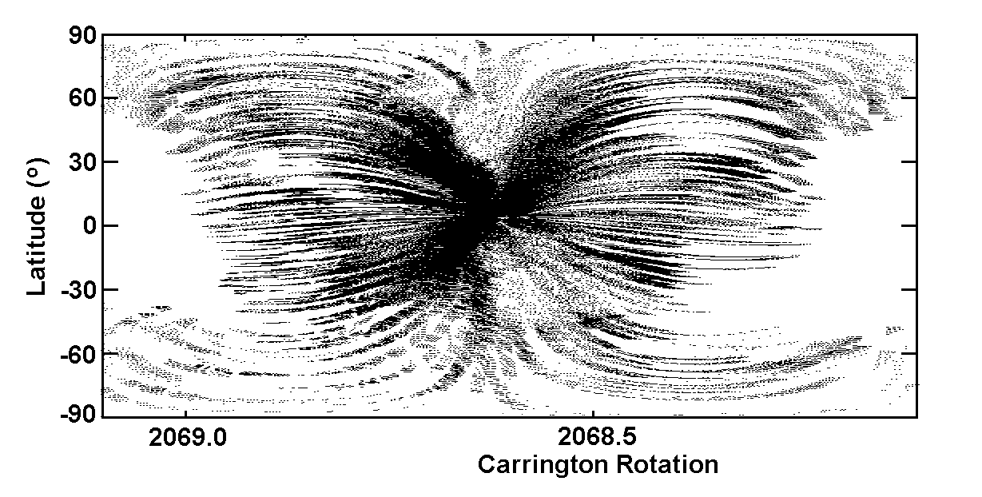
Thomson-Scattering B & pB Line-of-Sight Response
Jackson, B.V., et al., 2008, Adv. in Geosciences 21, 339
Jackson et al., 2020, Frontiers in Astronomy and Space Sci., doi: 10.3389/fspas.2020.568429
Heliospheric C.A.T. analyses:
example line-of-sight distribution for each sky location to form the source surface weighting of the 3-D reconstruction.
Thomson Scattering CAT Analysis
Billings, D.E., 1966, Academic, New York, p.150
From SMEI (6 hr difference- 1/25 # of LOS)
3-5 Million LoS in a one-month interval
Notes:
The analysis of ASHI is designed to fit an existing Computer Assisted Tomography fit to data, Using the known data line of sight (LoS) weighting, and a first guess of densities, an iterated solution model that assumes mass and mass flux conservation can iterated to provide a fit to the brightness observed. As heliospheric structures move outward. To the upper left is the weighting from the Thomson-scattering signal at three different elongations, 30, 60, and 90 degrees. L

Slide 11
Examples of
B Analyses

Slide 12
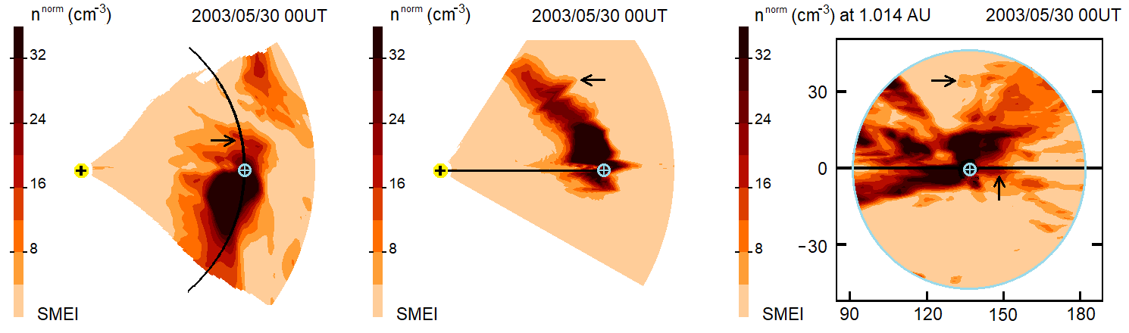
Jackson et al., 2020 doi: 10.3389/fspas.2020.568429
Ecliptic, Earth Meridional, and Synoptic Cuts at 1.5-Hour Cadence Resolution
SMEI Analysis
2003 May 27-28 CME events
High Res Analyses show CMEs corrugated and spotty!
Ecliptic Cut Meridional Cut Synoptic Cut

Slide 13
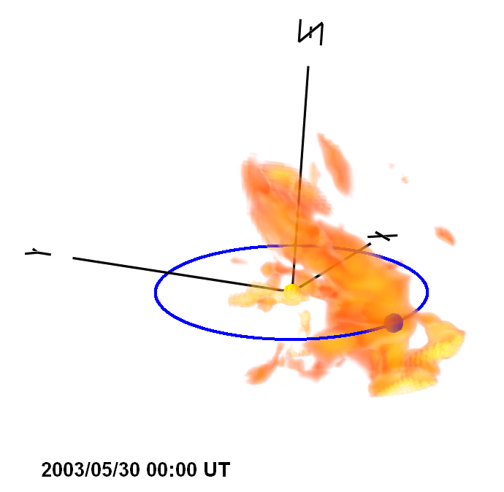
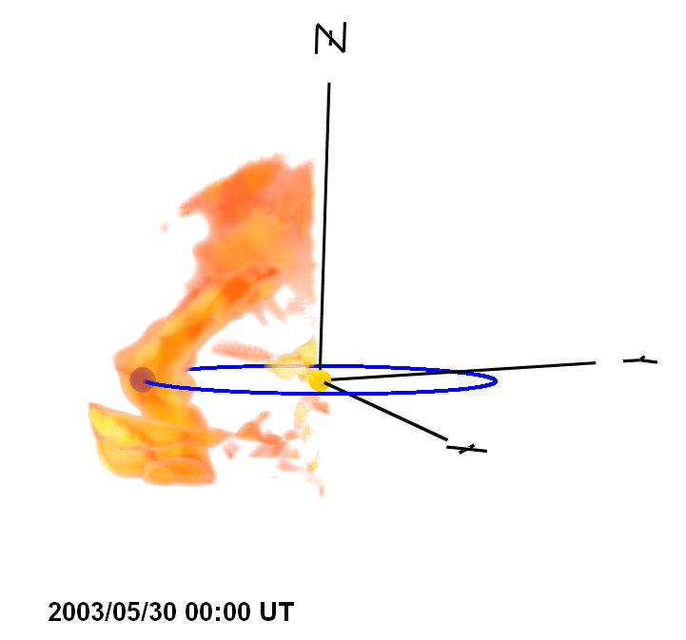
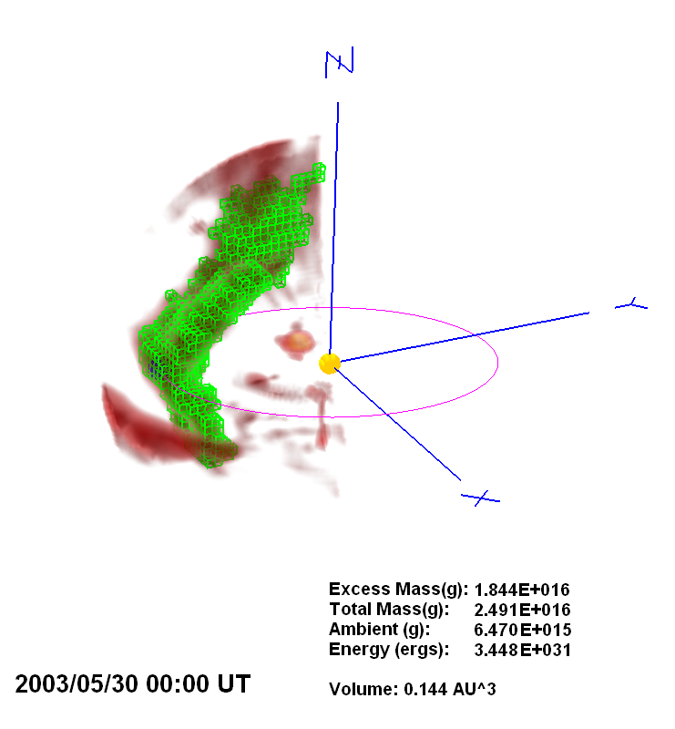
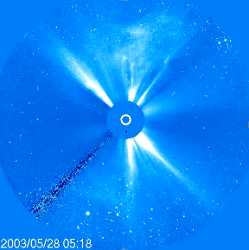
Jackson, B.V., et al., 2008, J. Geophys Res., 113, A00A15, doi:10.1029/2008JA013224
2003 May 27-28 CME events
SMEI Analysis
SMEI density 3D reconstruction of the 28 May 2003 halo CME as viewed from 15º above the ecliptic plane about 30º east of the Sun-Earth line.
CME mass
SMEI density (remote observer view) of the 28 May 2003 halo CME

Slide 14
Higher Resolution and
Closer to the Sun
PUNCH “practice”

Slide 15
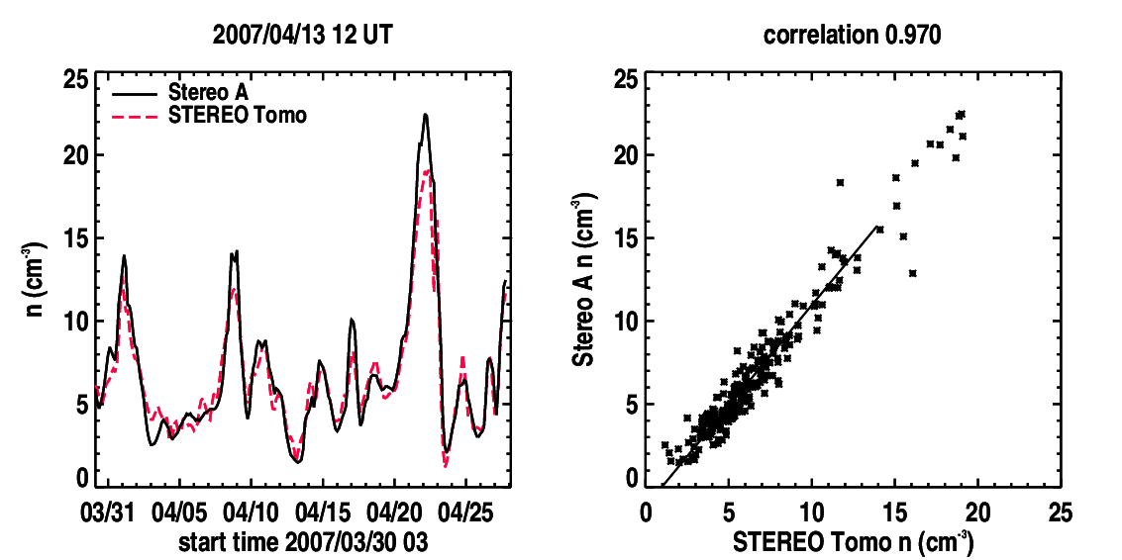
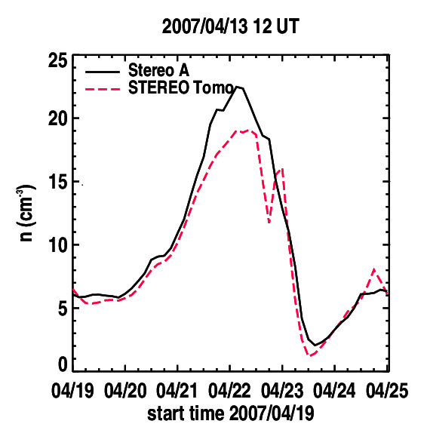
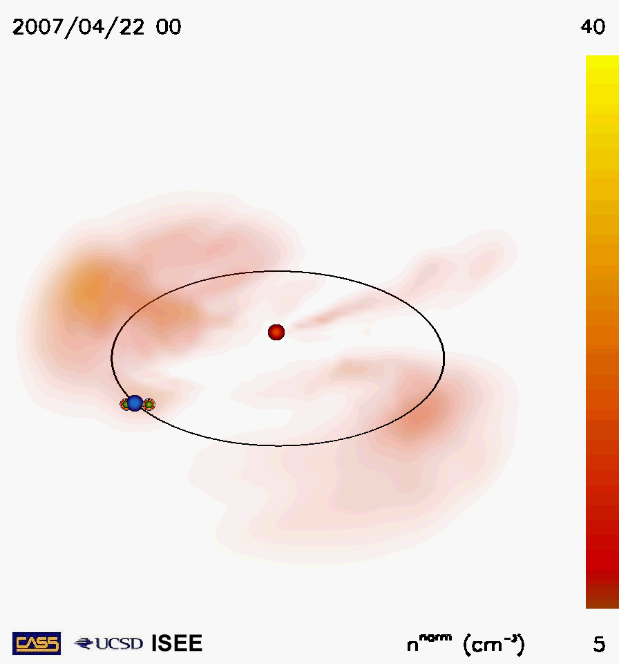
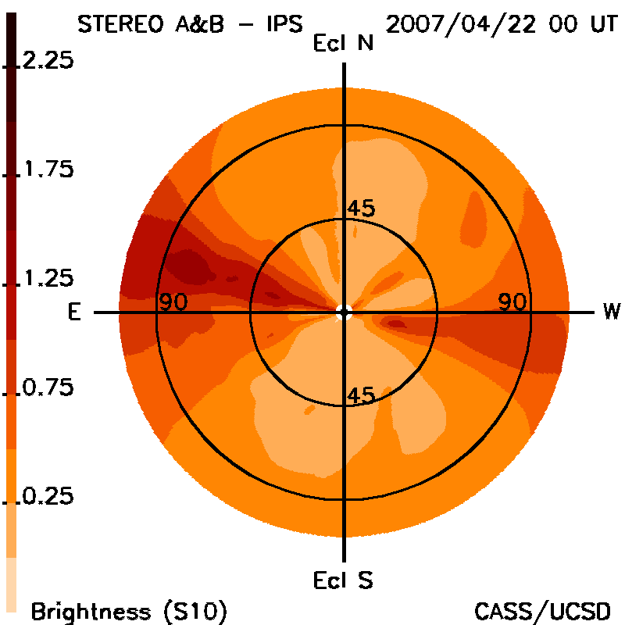
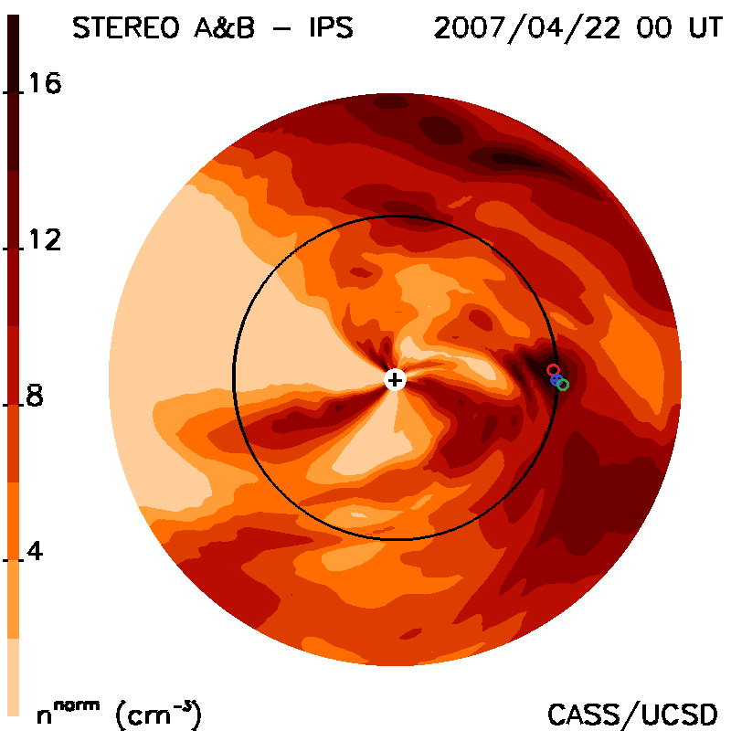
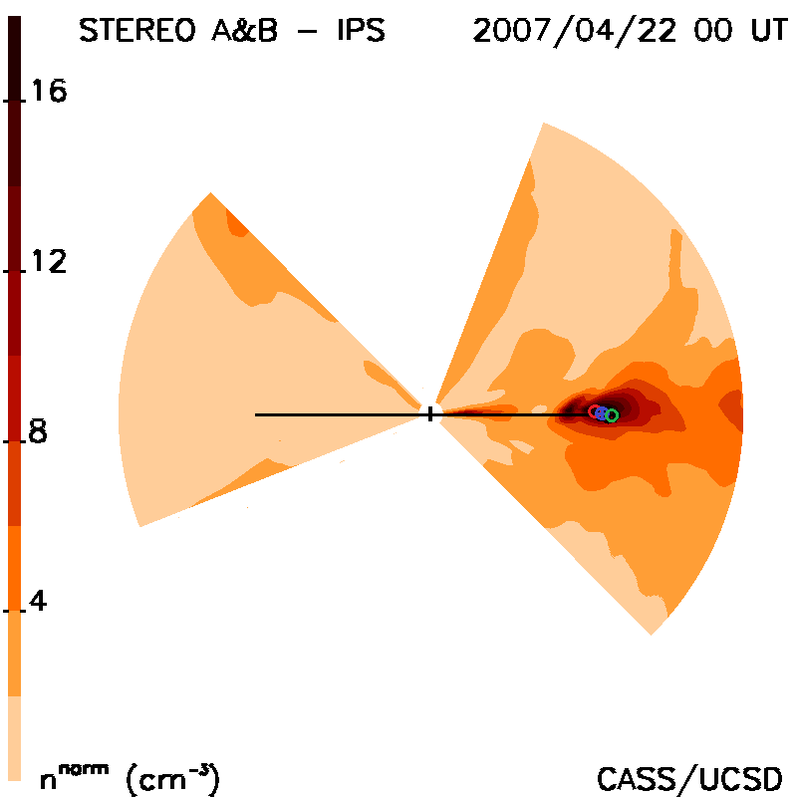
Jackson et al., 2020 doi: 10.3389/fspas.2020.568429
STEREO A&B HI 1 Low Res B
2007 March 31- April 28 events
12-Hour 3-D Reconstructions
Sample Structure Views
Month-long Time Series 6-days CME
Remote View Skymap Ecliptic Cut Meridional

Slide 16
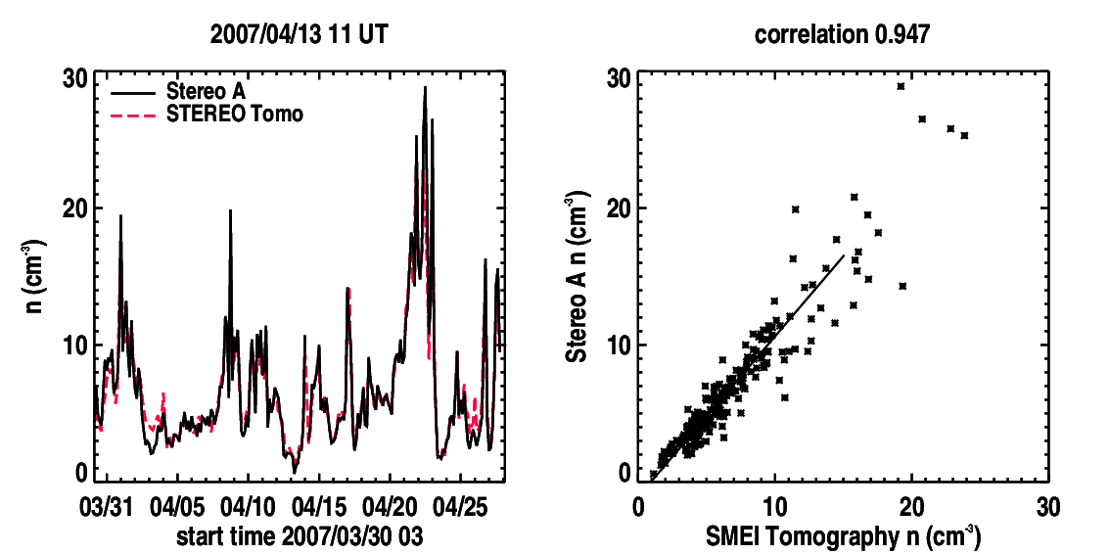
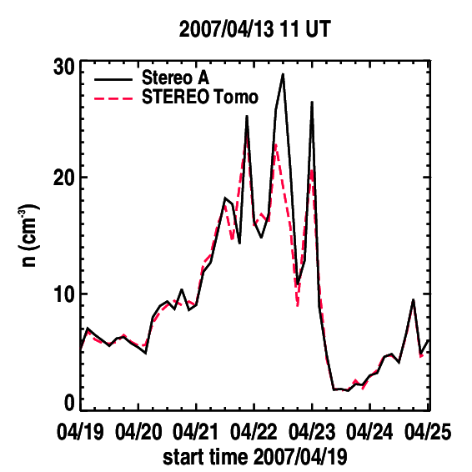
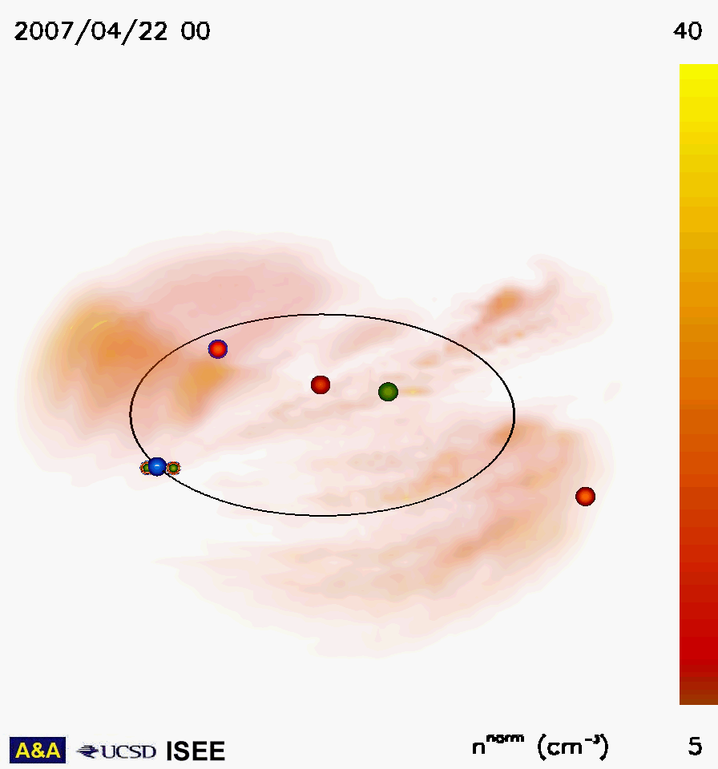
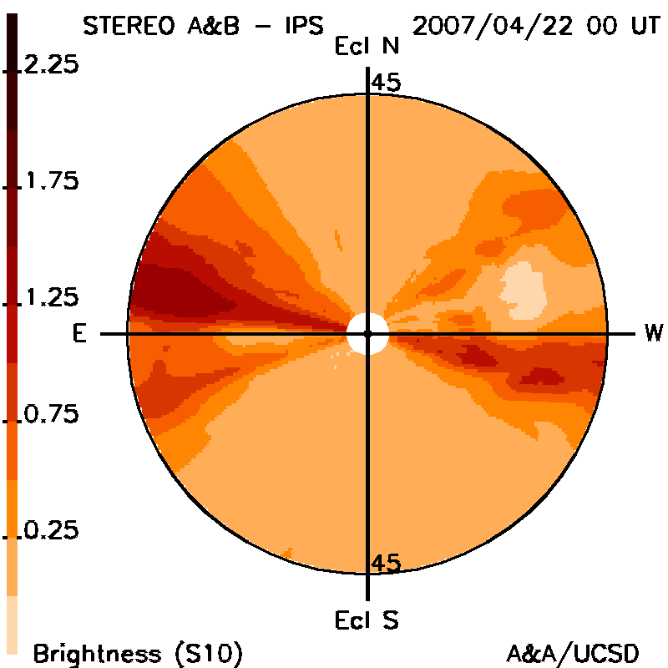
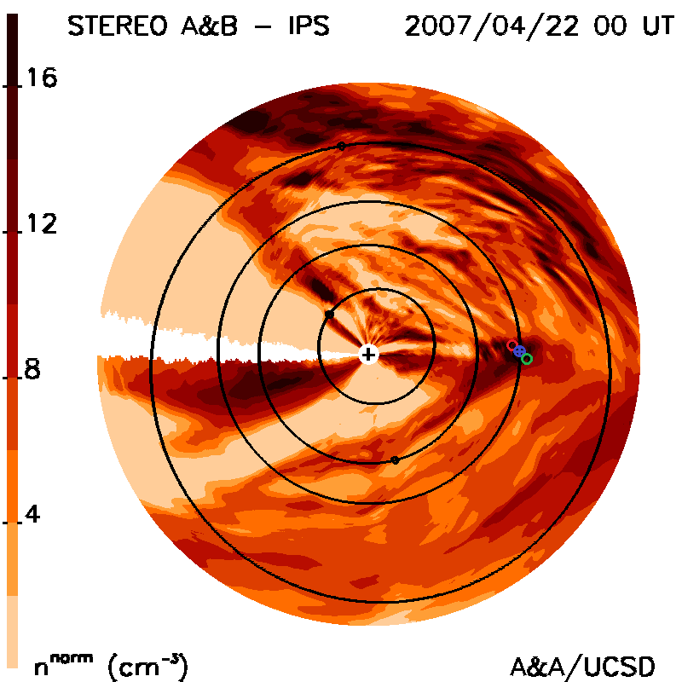
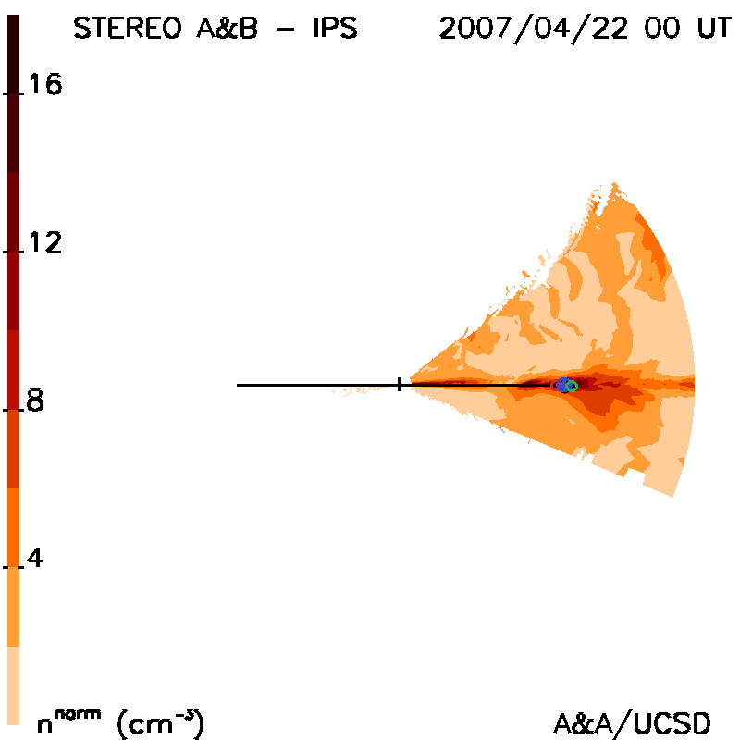
Jackson et al., 2020 doi: 10.3389/fspas.2020.568429
STEREO A&B HI 1 High Res B
2007 March 31- April 28 events
12-Hour 3-D Reconstructions
Sample Structure Views
Month-long Time Series 6-days CME
Remote View Skymap Ecliptic Cut Meridional

Slide 17
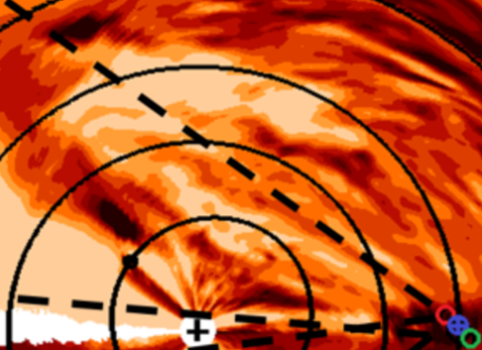
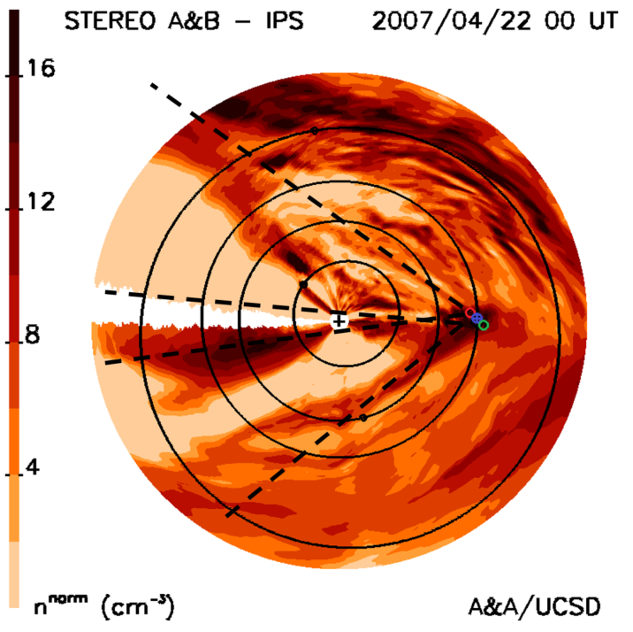
2007 March 31- April 28 High Resolution Analyses Closer Look
The only near-Sun location that can be 3-D reconstructed directly with PUNCH is inside the dashed lines. Everything else is an extrapolation.

Slide 18
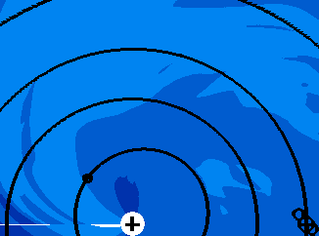
2007 March 31- April 28 High Resolution Analyses Closer Look
IPS Velocity
Low Resolution IPS
The only near-Sun location that can be 3-D reconstructed directly with PUNCH is inside the dashed lines. Everything else is an extrapolation.

Slide 19
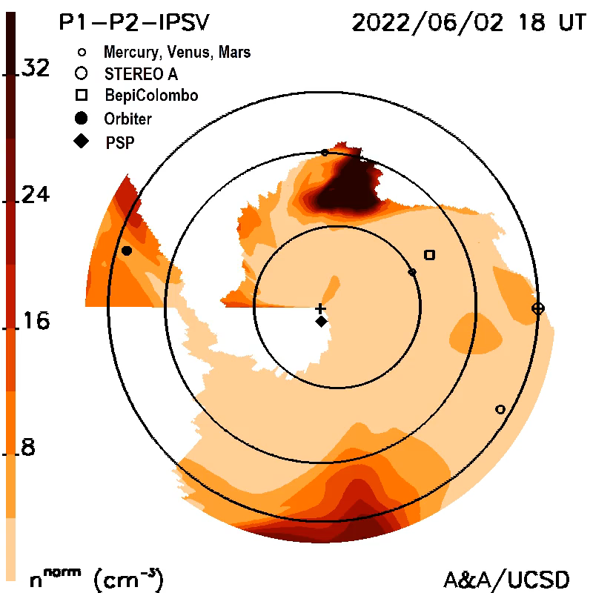
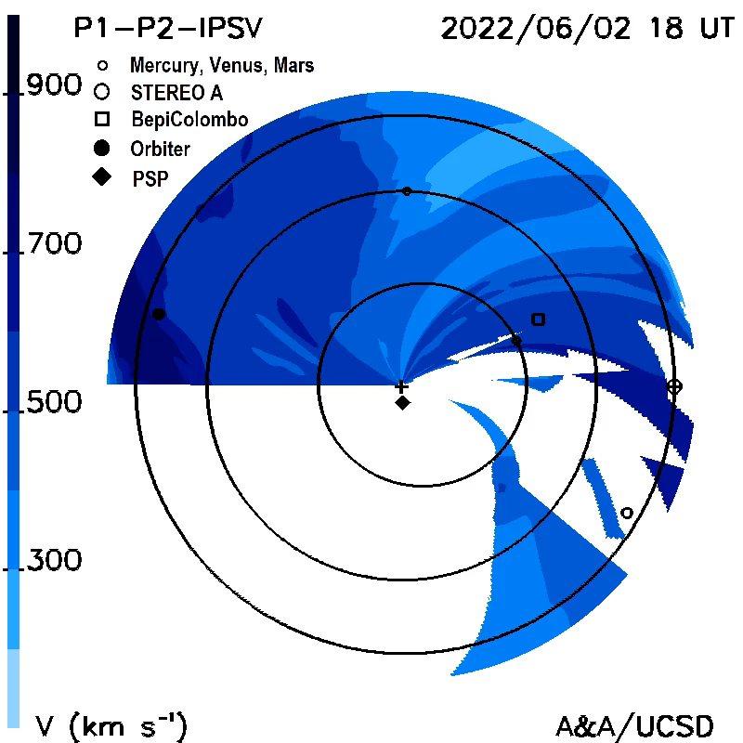
Parker WISPR 3-D reconstructions of a June 2, 2022, CME
New (3 weeks)
Parker
Parker
Parker
WISPR Density Ecliptic Cut IPS Velocity Cut

Slide 20
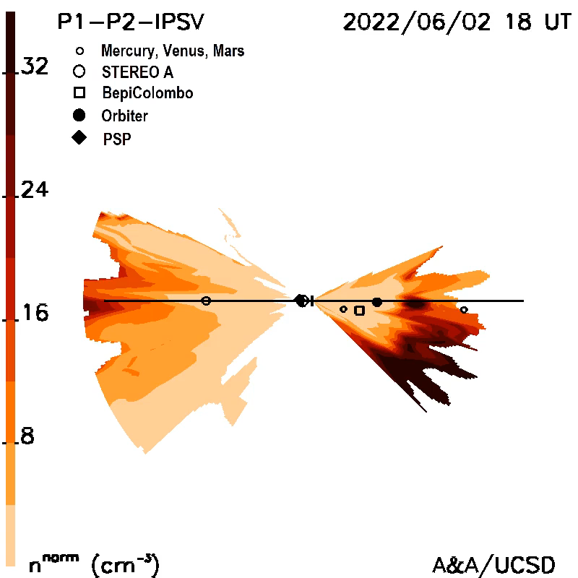
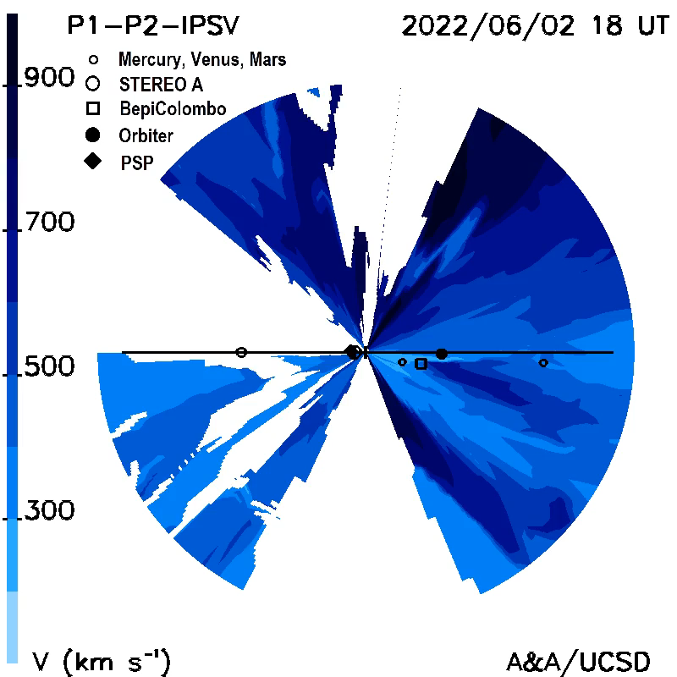
Parker WISPR 3-D reconstructions of a June 2, 2022, CME
Parker
Parker
WISPR Meridional 90⁰ in Front of Parker Cut IPS 90⁰ Velocity Cut

Slide 21
Thomson Scattering
B & pB Analyses

Slide 22
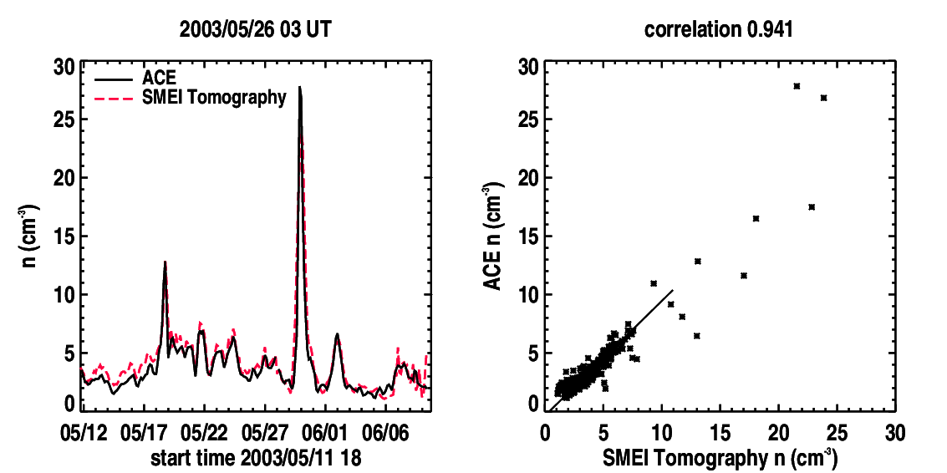
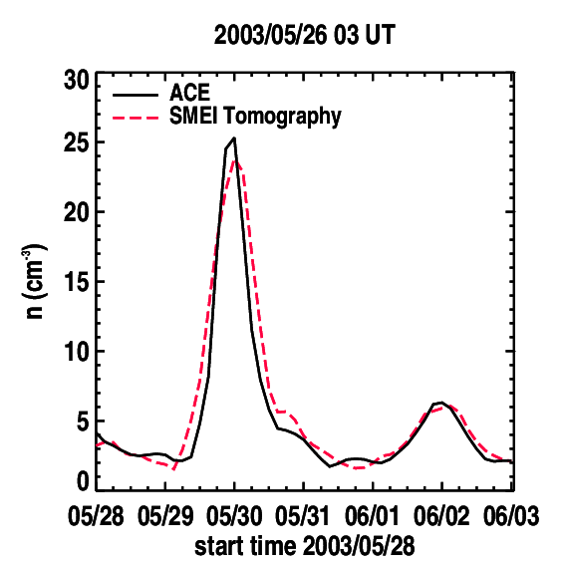
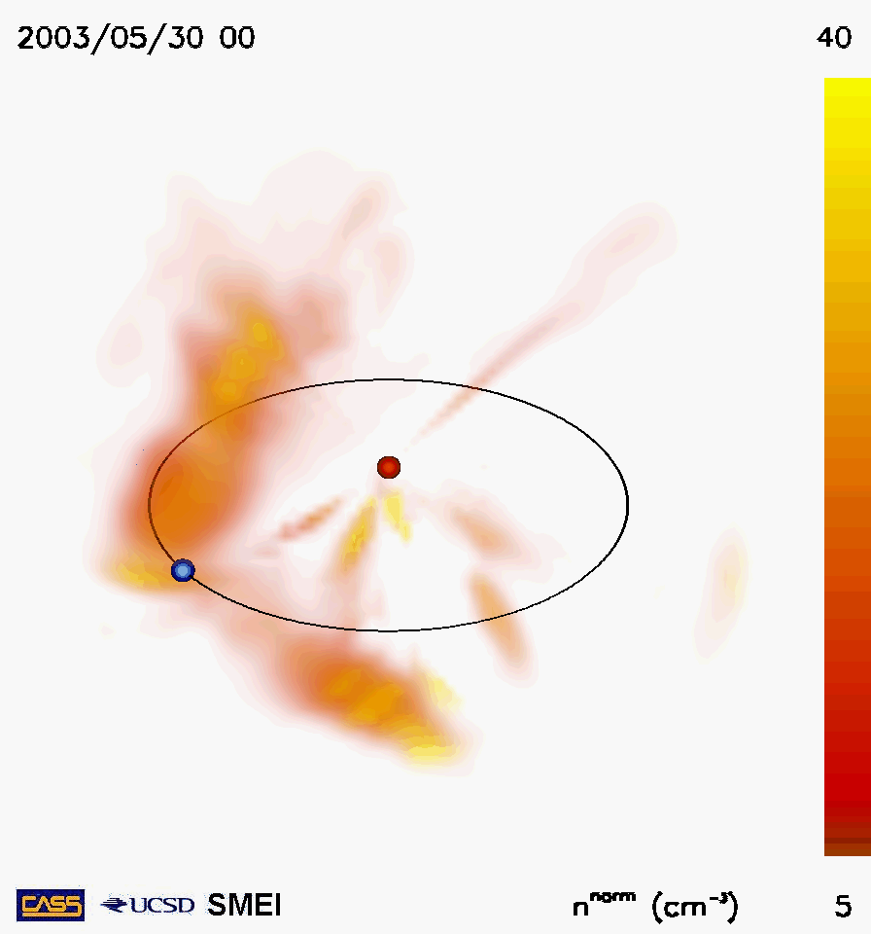
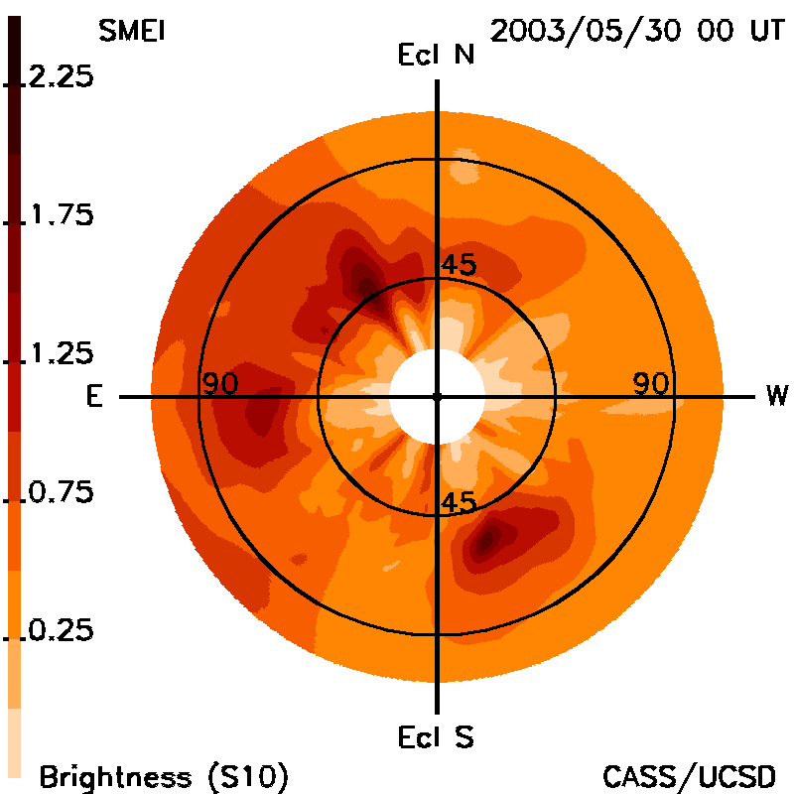
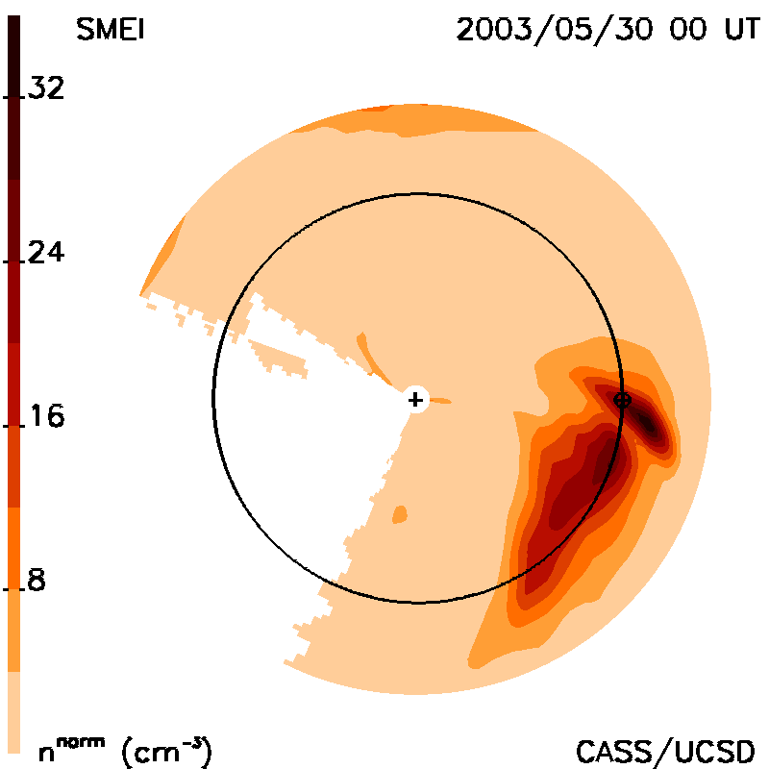
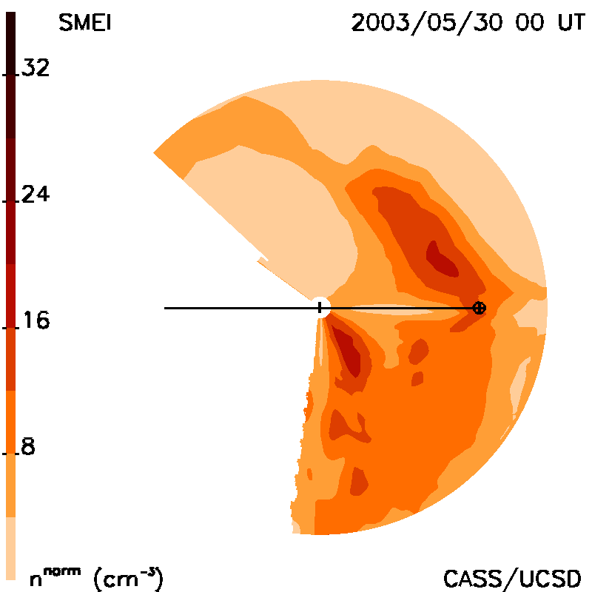
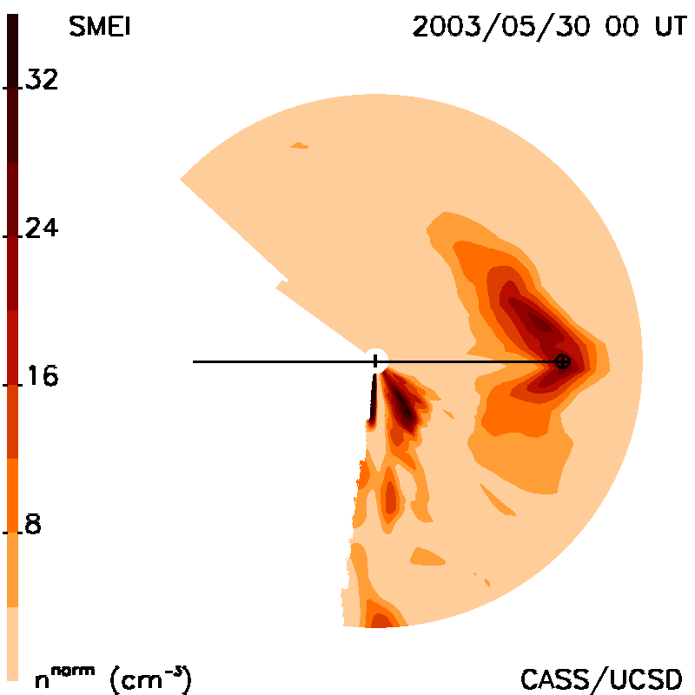
Jackson et al., 2020 doi: 10.3389/fspas.2020.568429
SMEI Low Res B Analysis
2003 May 27-28 CME events
12-Hour 3-D Reconstructions
Sample CME Views
Month-long Time Series 6-days CME
Remote View Skymap Ecliptic Cut Meridional

Slide 23
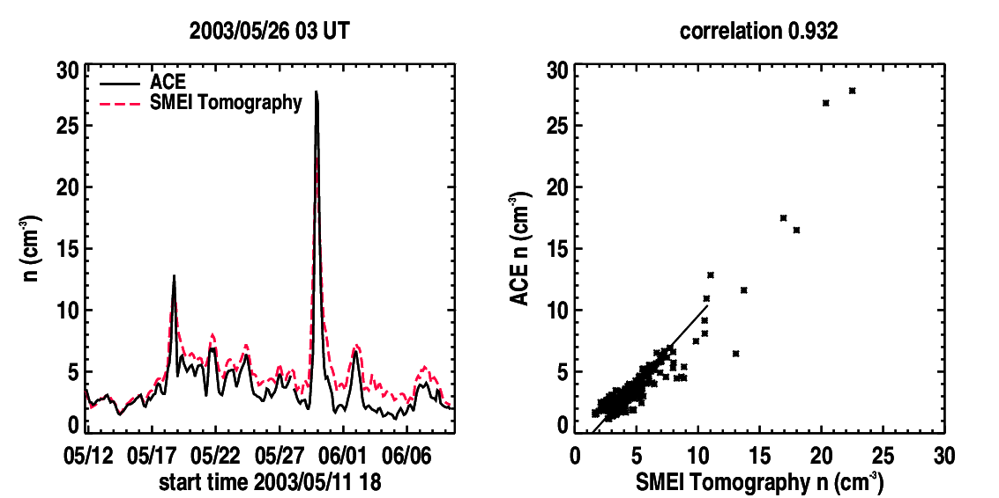
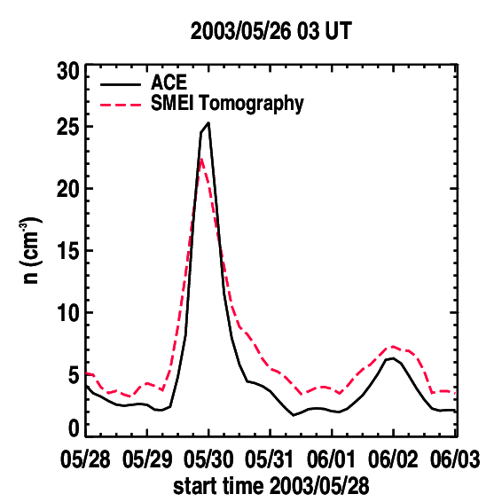
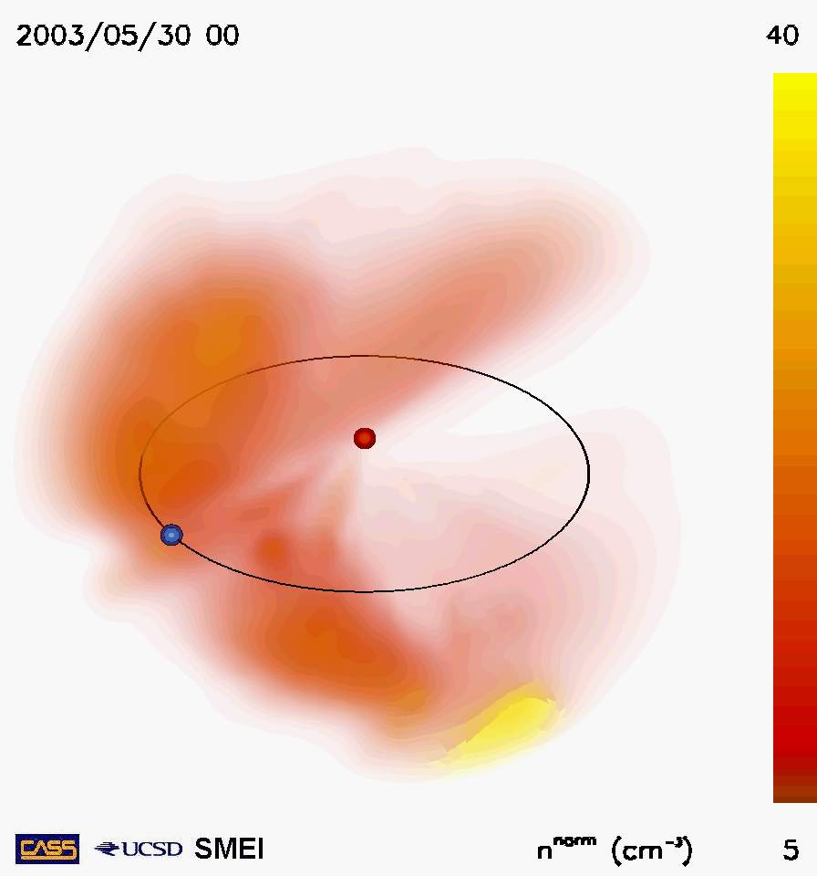



Jackson et al., 2020 doi: 10.3389/fspas.2020.568429
SMEI LR Pseudo B Analysis
2003 May 27-28 CME events
12-Hour 3-D Reconstructions
Sample CME Views
Month-long Time Series 6-days CME
Remote View Skymap Ecliptic Cut Meridional

Slide 24





Jackson et al., 2020 doi: 10.3389/fspas.2020.568429
SMEI LR Pseudo pB Analysis
2003 May 27-28 CME events
12-Hour 3-D Reconstructions
Sample CME Views
Month-long Time Series 6-days CME
Remote View Skymap Ecliptic Cut Meridional

Slide 25
Caveats:
The analyses show images interpolated to a given instant in time, not how the data were actually obtained over a period of a few minutes, with each LoS different from one another from the IPS or SMEI data.
To be expedient I used the LoS only from density proxy observations, not the proxy speeds, and gave these times of the LoS, not the actual images. These were made into data files and re-read into the program.
The images show volumes where data were sufficient to make an accurate 3-D reconstruction, but to provide the pseudo LoS, each volume was filled completely and then that pseudo observation used.

Slide 26
In the Meantime

Slide 27


Current UCSD Modeling
(Zhao, X. P. and Hoeksema, J. T., 1995, J. Geophys. Res., 100 (A1), 19.)
CSSS model
Dunn et al., 2005, Solar Physics 227: 339–353.
Source surface B_{r} field component sample at 15 Rs
Inner region: the CSSS model calculates the magnetic field using
photospheric measurements and a horizontal current model.
2. Middle region: the CSSS model opens the field lines. In the outer region.
3. Outer region: the UCSD tomography convects the magnetic field along velocity flow lines.

Slide 28

Kp Machine Learning Forecast
2017 spring
Since our analyses allow measurements of photospheric fields to be extrapolated into the heliosphere via our as GSM Bz at 1 AU. model velocity interactions, component fields can then be displayed and this plus forecast velocity, and density can be used to deter-mine planetary Kp.

Slide 29


Kp Machine Learning Forecast
Our analysis allows measurements of photospheric fields to be extrapolated into the heliosphere via our model velocity interactions. Component fields can then be displayed as GSM Bz at 1 AU.
We can now provide Kp by combining velocity, density, and component magnetic field forecasts
2024 Specific Example

Slide 30



Kp Machine Learning Forecast
Our analysis allows measurements of photospheric fields to be extrapolated into the heliosphere via our model velocity interactions. Component fields can then be displayed as GSM Bz at 1 AU.
We can now provide Kp by combining velocity, density, and component magnetic field forecasts
(https://ips.ucsd.edu/experimentalforecasts)
2024/09/10 03UT Specific Example

Slide 31

Kp Machine Learning Forecast
Our analysis allows measurements of photospheric fields to be extrapolated into the heliosphere via our model velocity interactions. Component fields can then be displayed as GSM Bz at 1 AU.
We can now provide Kp by combining velocity, density, and component magnetic field forecasts
(https://ips.ucsd.edu/experimentalforecasts)
2024/09/12 21UT Actual Result

Slide 32








2022/03/10 CME
2022/03/12 21 UT
A Good Recent IPS CME Forecast
Jackson, B.V., 2023,
Solar Phys., doi:10.1007/s11207-023-02169-8.
IPS Ecliptic Cut IPS Meridional Cut
Time Series Comparison Pearson’s “R” Correlation

Slide 33


MetaQuest Animations Poster 118
VR Lab Work (Ben)
Mario & Bernie
(COSPAR 2024)

Slide 34
Conclusion:
The UCSD time-dependent 3D reconstruction analysis – Interplanetary Scintillation (IPS)
Analysis modification to provide very high resolution Thomson scattering pseudo brightness and polarization brightness:
SMEI, STEREO A HI’s, Parker Probe (New), PUNCH (Future)
More
Notes:
Introduction

